Slide 1
Weather observations 29.03.2021

Slide 2
29.03.2021 00 UTC
Sea ice fraction

Slide 3
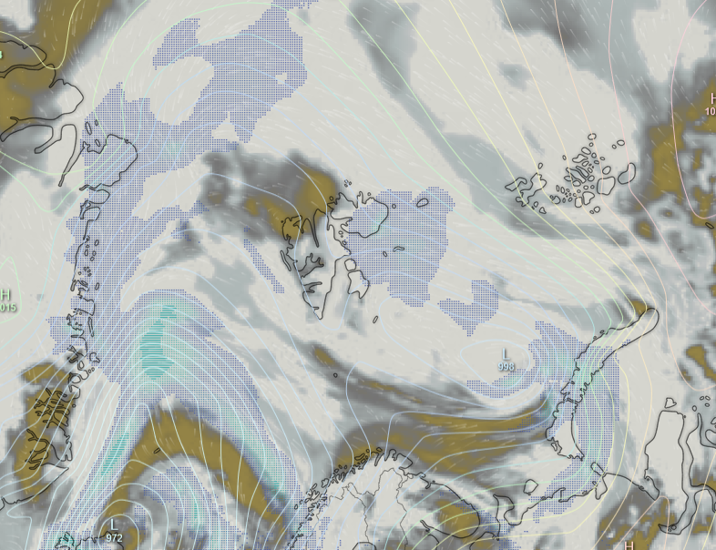
29.03.2021 00 UTC
Surface air pressure
Low over Iceland
southward cold air transport along the ice edge west of Low
surface air pressure, streamlines, clouds, precipitation

Slide 4
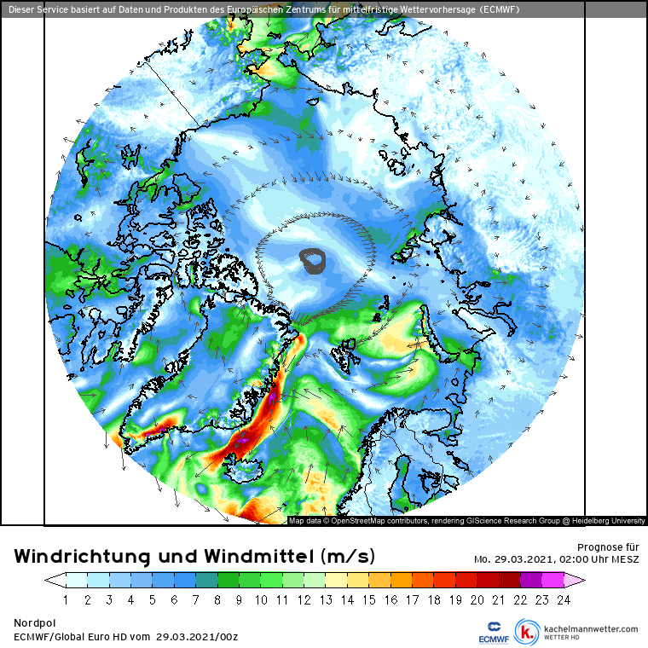
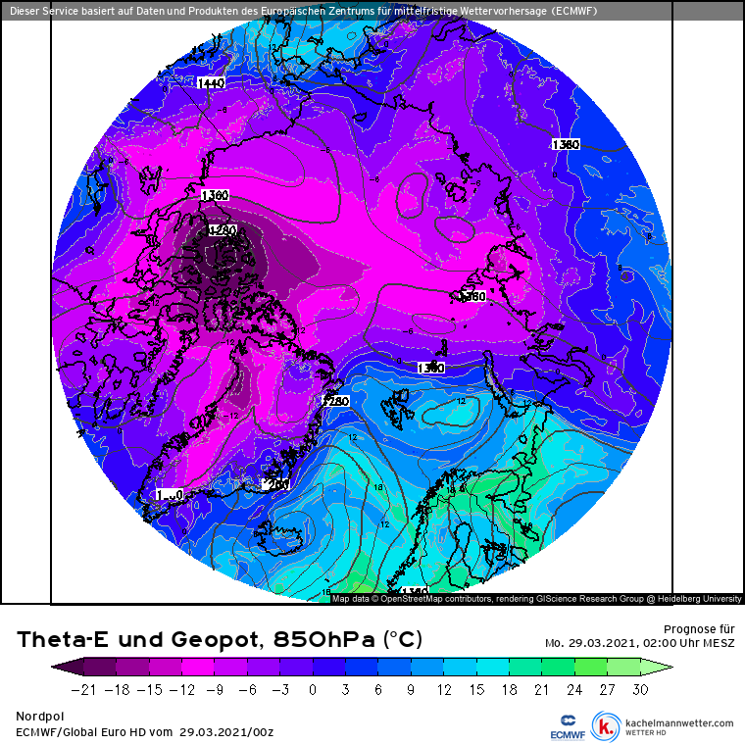
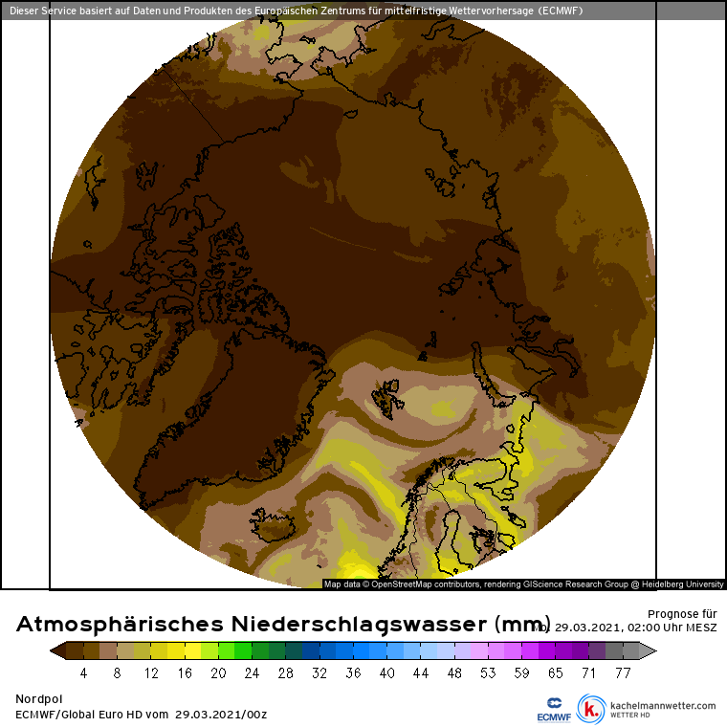
29.03.2021 00 UTC
Wind speed and streamlines
Theta-E and geopotential (850 hPa)
Precipitable water
No strong winds around Svalbard
Moist air advection over Atlantic from North Norway to Greenland

Slide 5
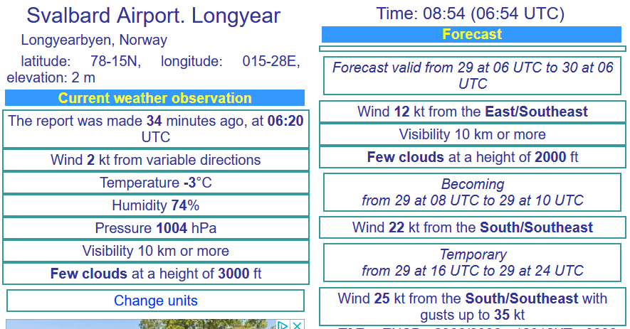
29.03.2021 – Situation at the airports
Longyearbyen
09:05 UTC

Slide 6
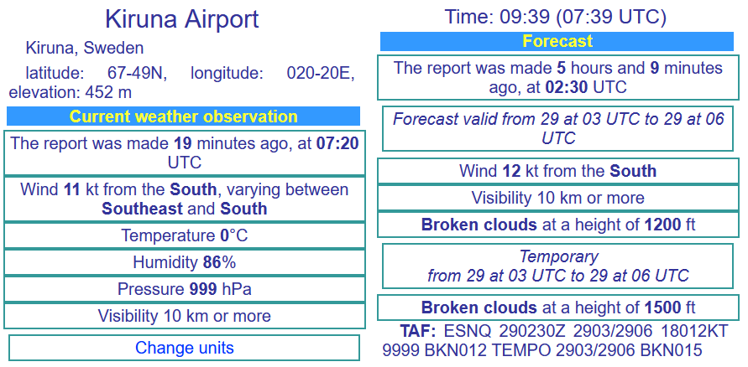
29.03.2021 – Situation at the airports
Kiruna

Slide 7
29.03.2021 12 UTC
Surface air pressure
Low weakens as it moves eastward

Slide 8
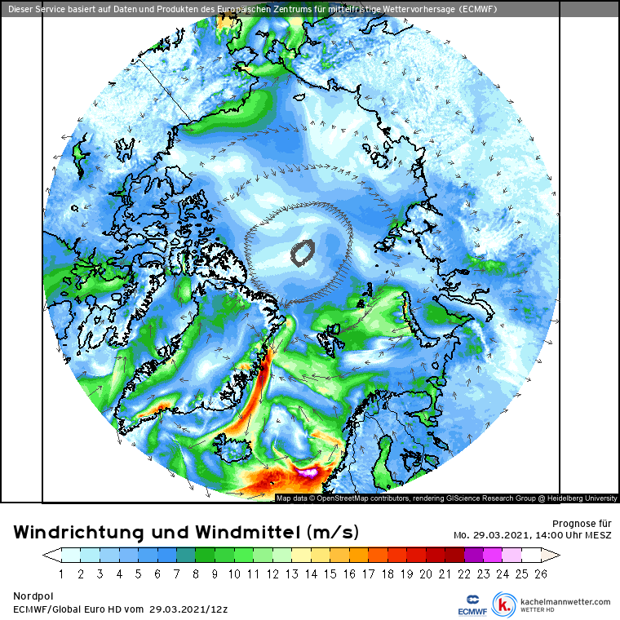
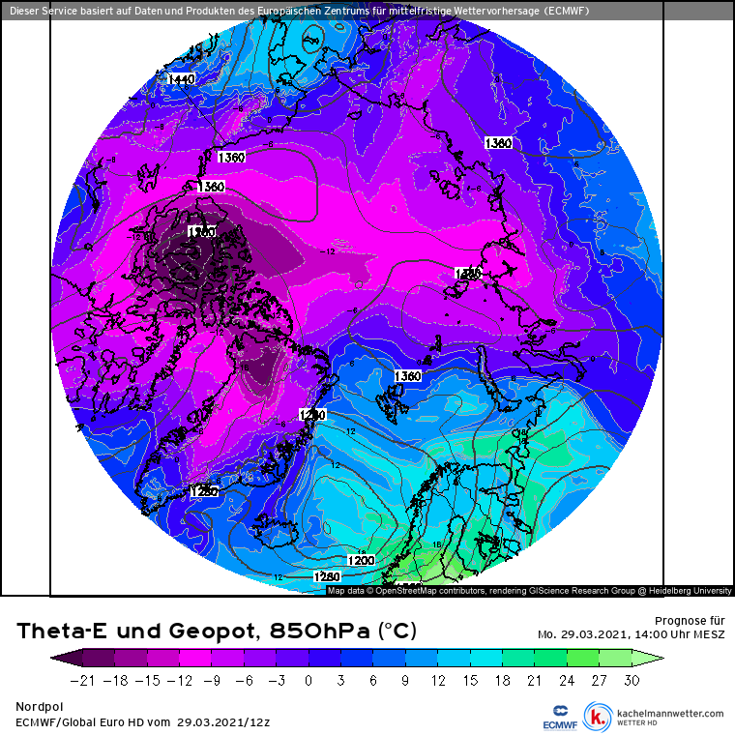
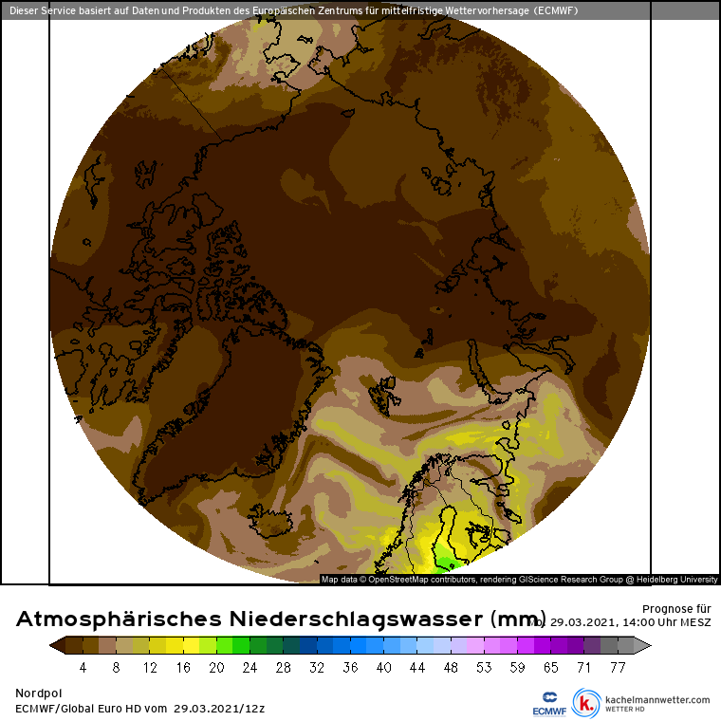
29.03.2021 12 UTC
Wind speed and streamlines
Theta-E and geopotential (850 hPa)
Precipitable water
Northerly wind west of the low weakens
Moist air advection over North Atlantic weakens

Slide 9
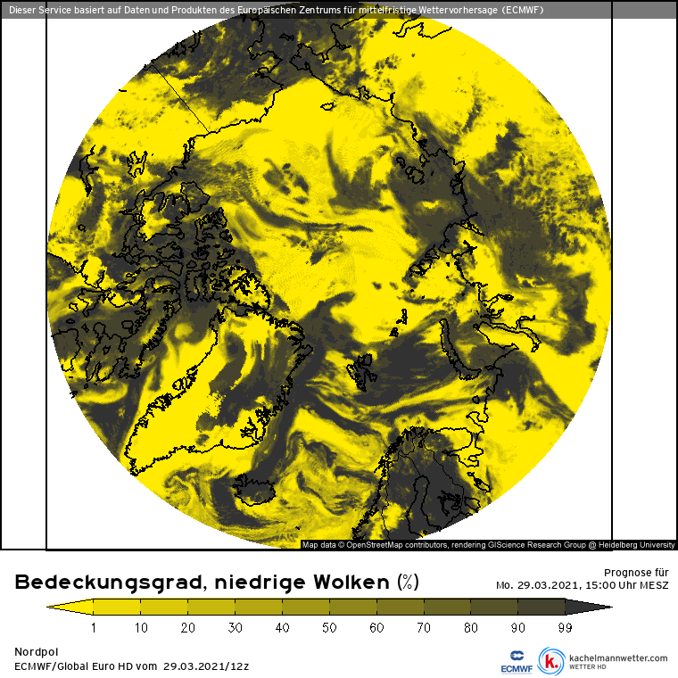
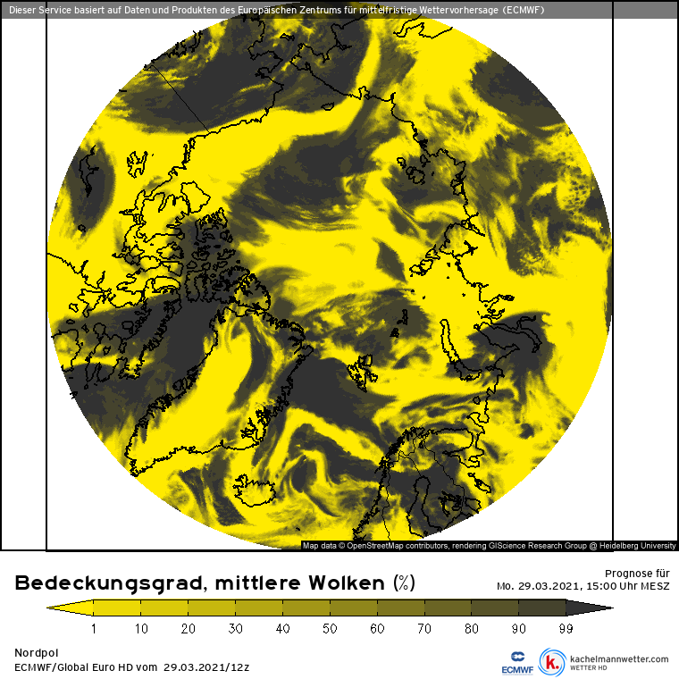
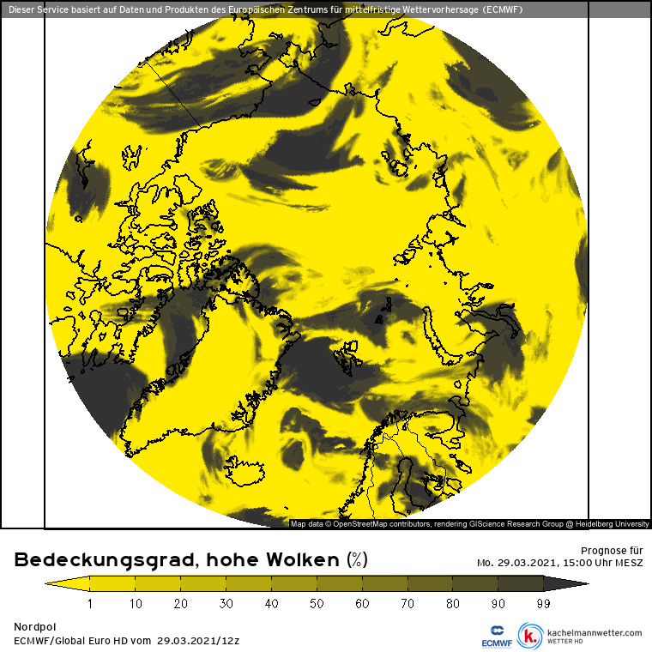
29.03.2021 13 UTC
Low-level clouds
Mid-level clouds
High-level clouds
Lots of low-level clouds especially east of Svalbard
Mid- and high-level clouds southwest of Svalbard in the moist air, but also to the North

Slide 10
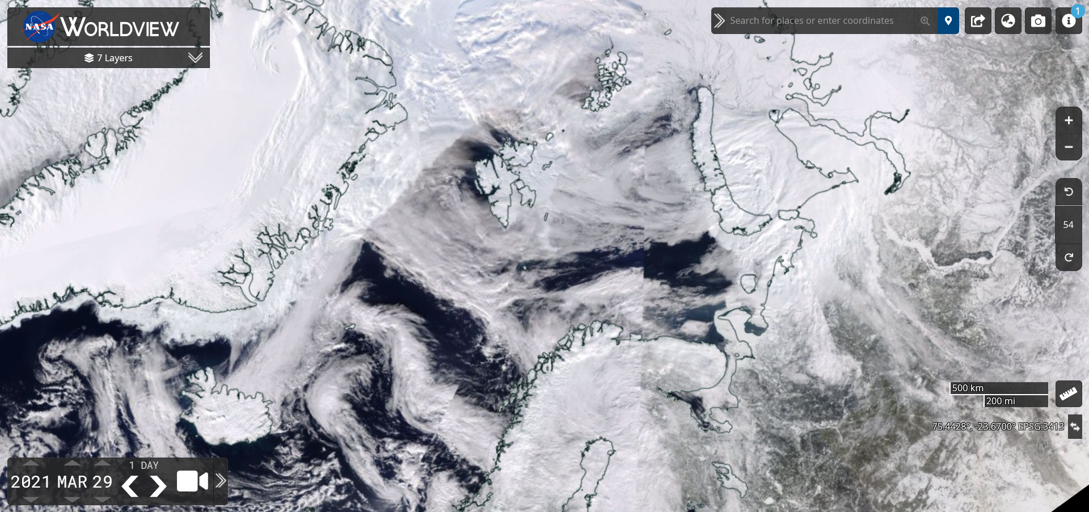
29.03.2021
Sea ice fraction

