Slide 1
Weather briefing HALO-(AC)³
Thursday, 2022-03-02 17:00

Slide 2
GO / NO GO Thursday, 2022-03-03
METAR LYR and KRN

Slide 3
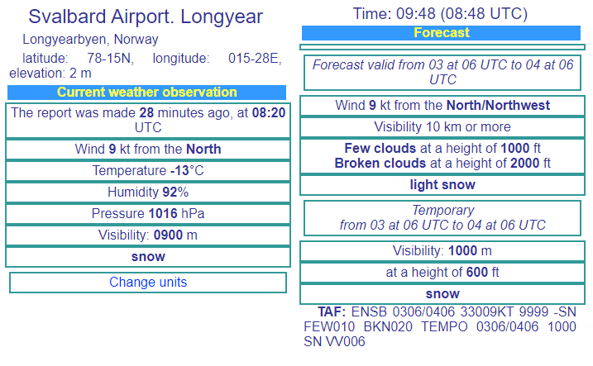
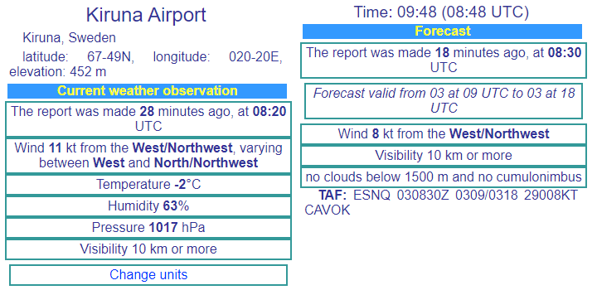
LYR
KRN
LYR: light snow, moderate visibility
KRN: no precip, good visibility

Slide 4
Surface Analysis 2022-03-02 00 UTC DWD

Slide 5
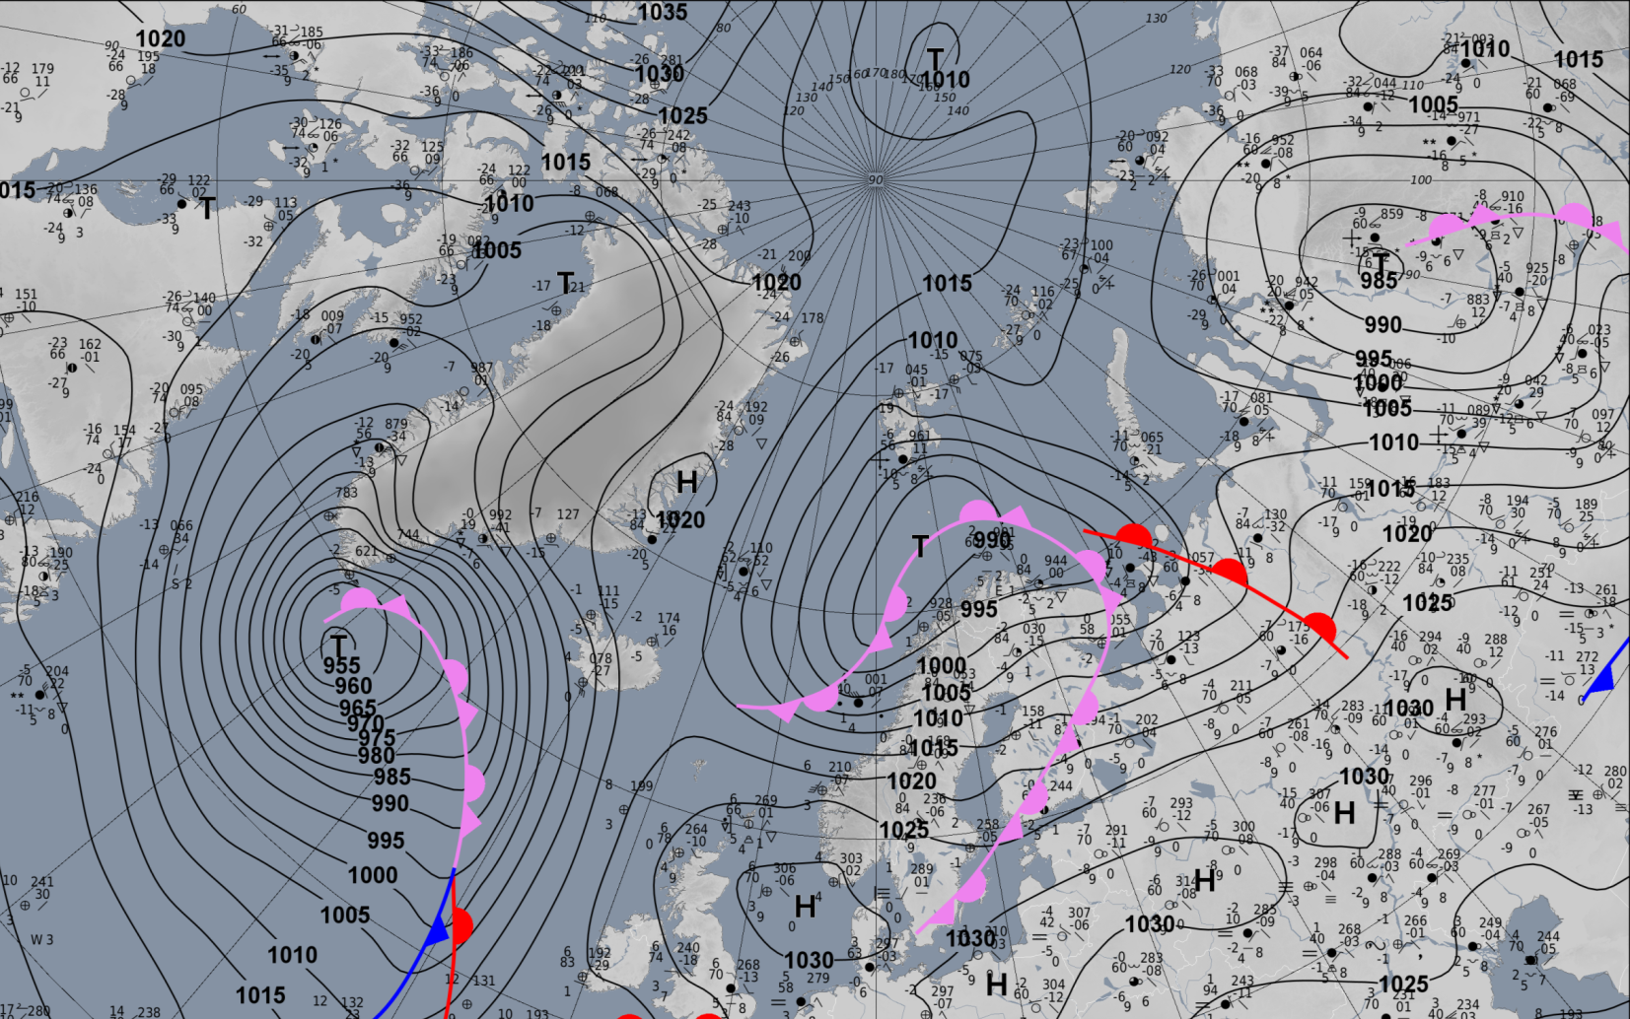
Wednesday, 2022-03-02 00 UTC
Notes:
old Low S of Sv. → northerly to northeasterliesy above Sv. and Framstr.
still transports cooled mid-lat air on its southern end
steering Iceland low (south of Greenland)
barometric swamp over Arctic ocean (no sign. air motion)

Slide 6
Circulation pattern development 2022-03-02 00 UTC: 00 – 72h 500 hPa Geopot & T Sea level pressure

Slide 7
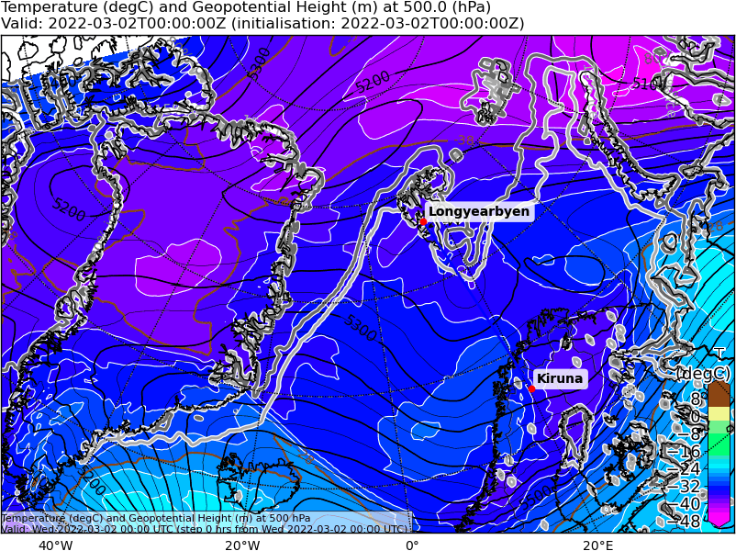
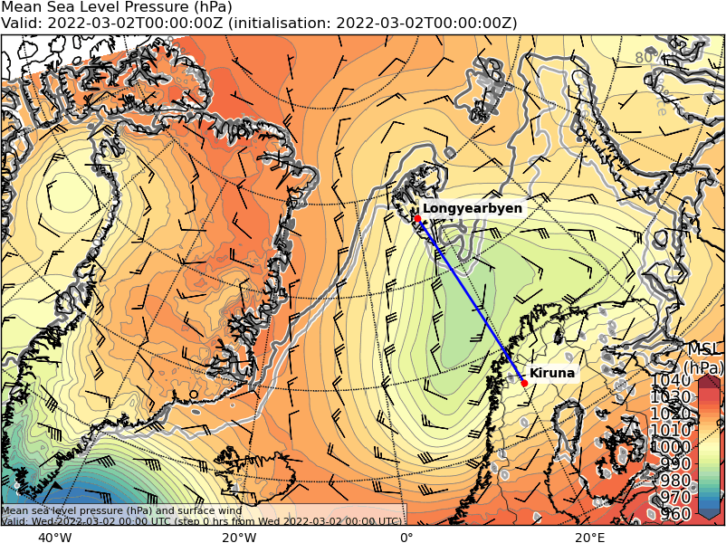
Wednesday, 2022-03-02 00 UTC (+00h)
500 hPa Geopot & T
Sea level pressure
Notes:
Warm and moist mid-lat air north of Norway
Cold Air High over Greenland
→ quite different wind regimes in Fram Strait in mid- and upper troposphere because of that H under cold pool

Slide 8
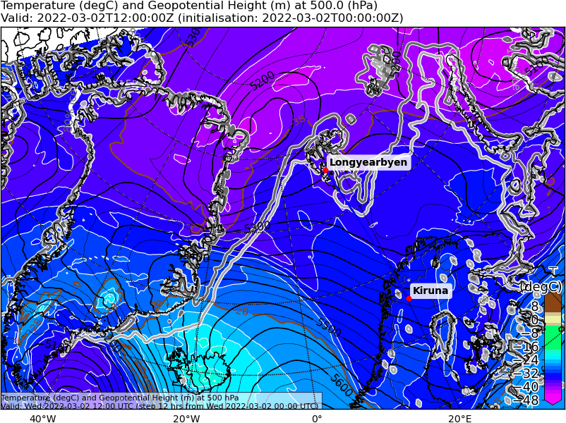
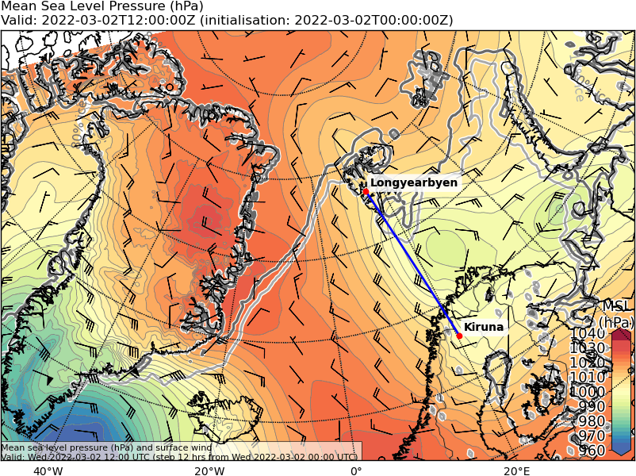
Wednesday, 2022-03-02 12 UTC (+12h)
500 hPa Geopot & T
Sea level pressure
Notes:
Warm air almost reaches LYR
Cold air on back side of Low advected southwards
little air movement in North Atlantic between the Lows
https://worldview.earthdata.nasa.gov/?v=-94757.17612037691,-1527678.1889126115,2353081.0725029577,-333082.12695424445&r=32.1120&p=arctic&t=2022-03-02-T16%3A22%3A21Z

Slide 9
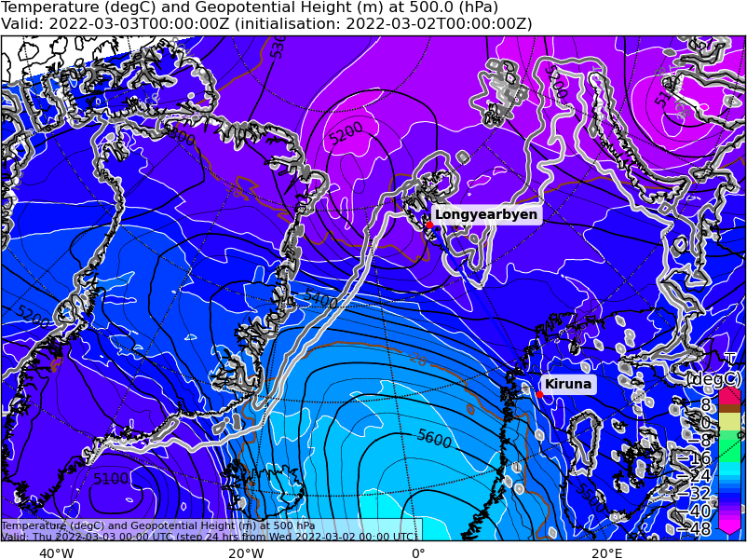
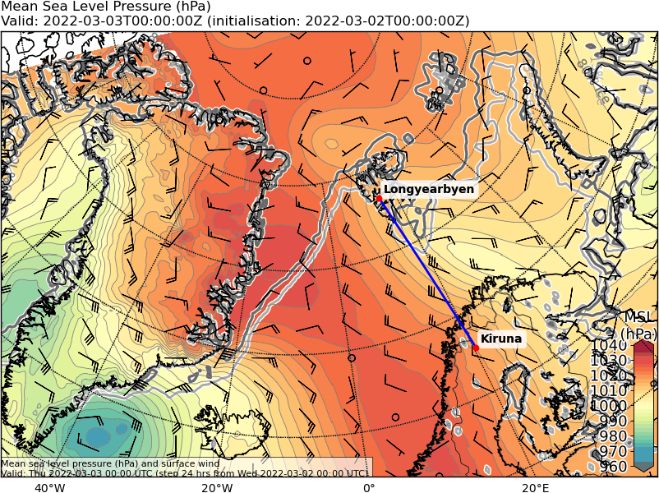
Thursday, 2022-03-03 00 UTC (+24h)
500 hPa Geopot & T
Sea level pressure
Notes:
Low south-east of Sv. dissipates; connected air mass cools down
cold air from Greenland and Fram Strait transported further towards Norway
Winds still quite perpendicular to Sea Ice Edge
troughs fade

Slide 10
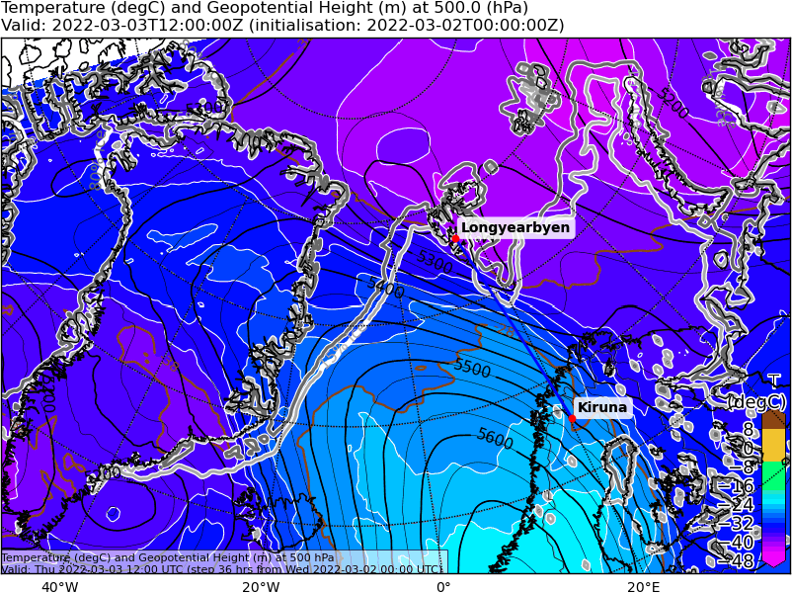
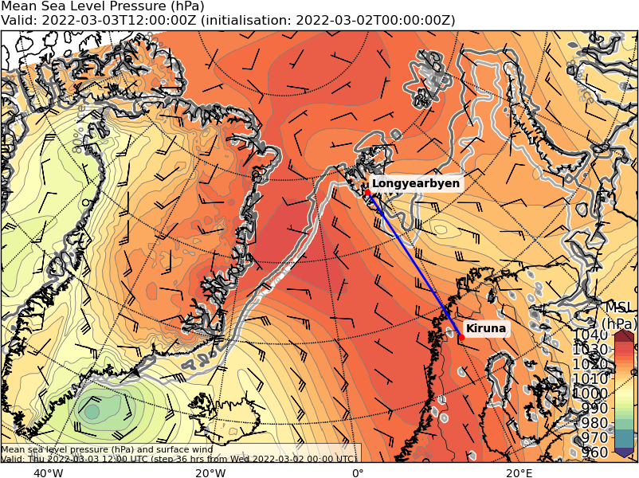
Thursday, 2022-03-03 12 UTC (+36h)
500 hPa Geopot & T
Sea level pressure
Notes:
air over Fram Strait slightly warms up (not movement related, but prolly gains heat from ocean)
Iceland low significantly fades but still pushes warm air northwards on its eastern edge
→ slight development potential because Low at front of trough
warm south east of Sv. almost gone, but Low still between Sv. and Norway

Slide 11
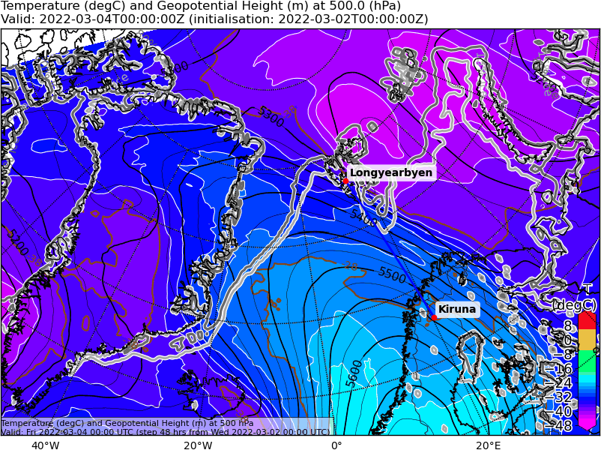
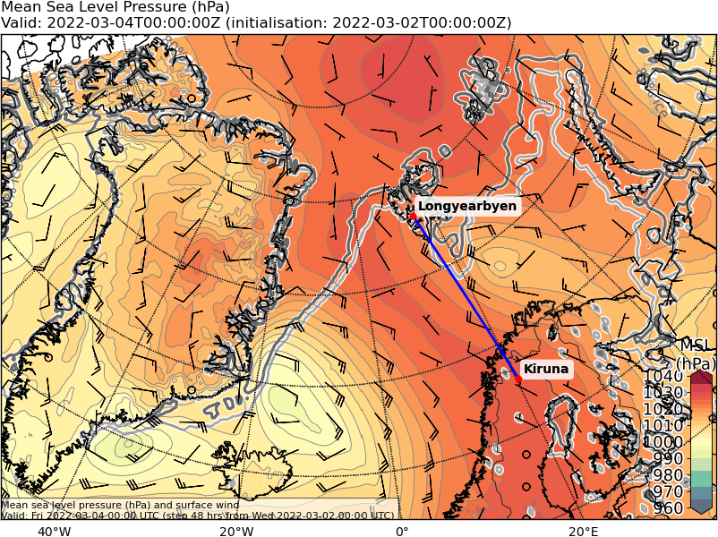
Friday, 2022-03-04 00 UTC (+48h)
500 hPa Geopot & T
Sea level pressure
Notes:
The low NE of Iceland deepened slightly, pushing warm air in a south-easterly fashion into the Fram Strait
low-level winds partly inverted compared to 2nd March;
south of Sv. still north-easterlies because that Low is still not totally gone

Slide 12
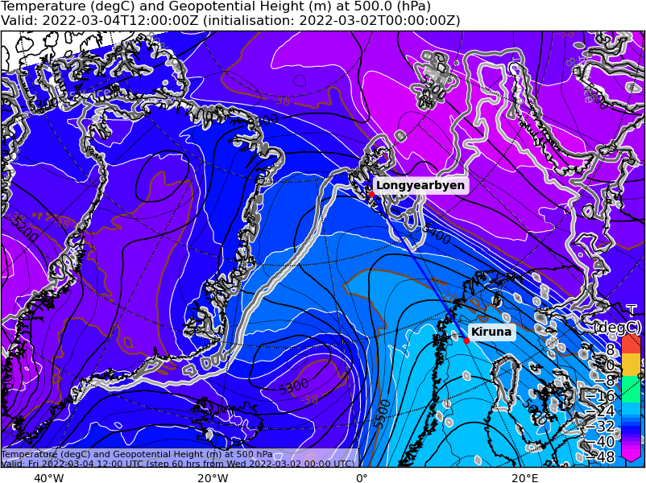
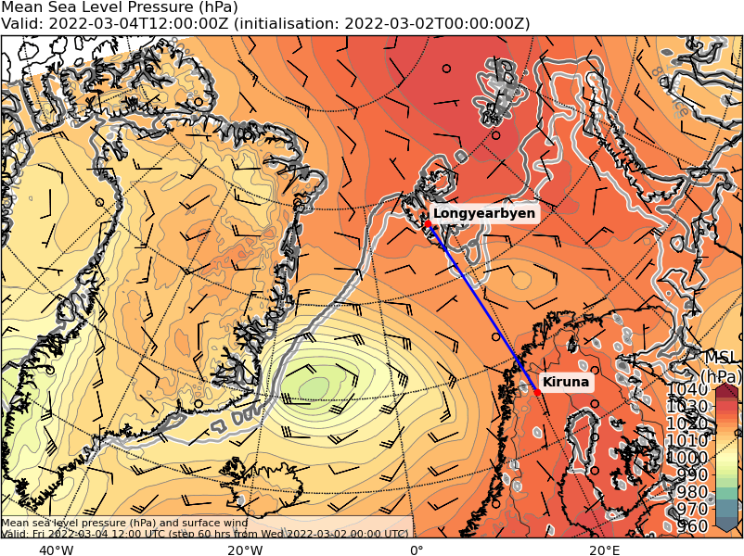
Friday, 2022-03-04 12 UTC (+60h)
500 hPa Geopot & T
Sea level pressure
Notes:
Iceland low deepens more but the short wave trough is quite tilted so that we don't really have a southerly flow there (rather easterly)
High NE of Svalbard → no longer two different sfc wind patterns in that area, but partly weak winds
former trough over Svalbard now gone

Slide 13
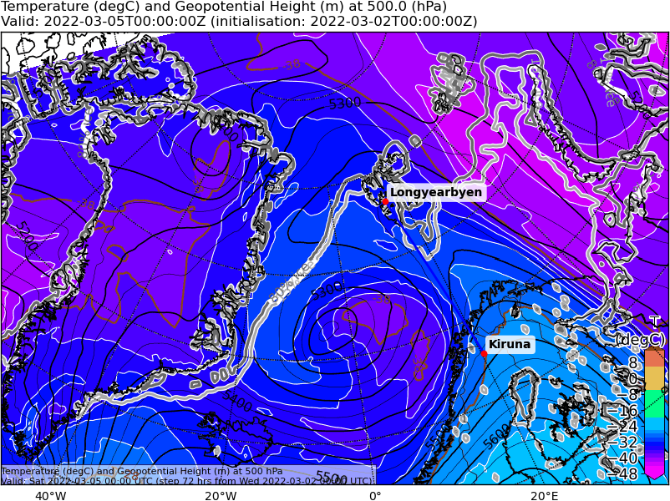
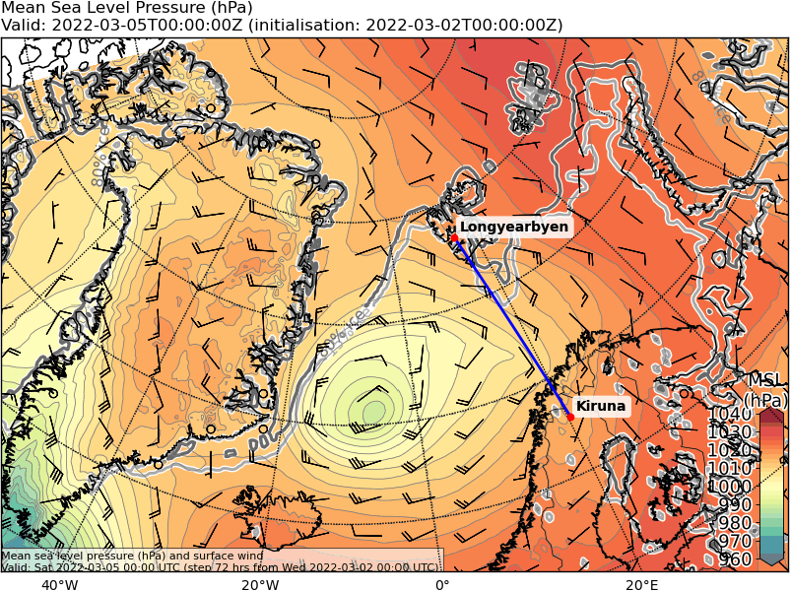
Saturday, 2022-03-05 00 UTC (+72h)
500 hPa Geopot & T
Sea level pressure
Notes:
WAA fades, but still slightly present; T850 still increased slightly
WAA over north Norway
orogr. enhanced precip at Norweg coast
strong cooling in North Greenland
Low N of Iceland still present, but now fully moist and warm core
→ no further development; also centered in trough; moderate blob of precip

Slide 14
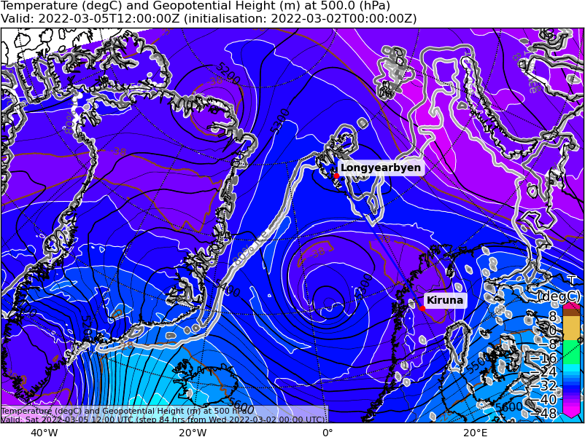
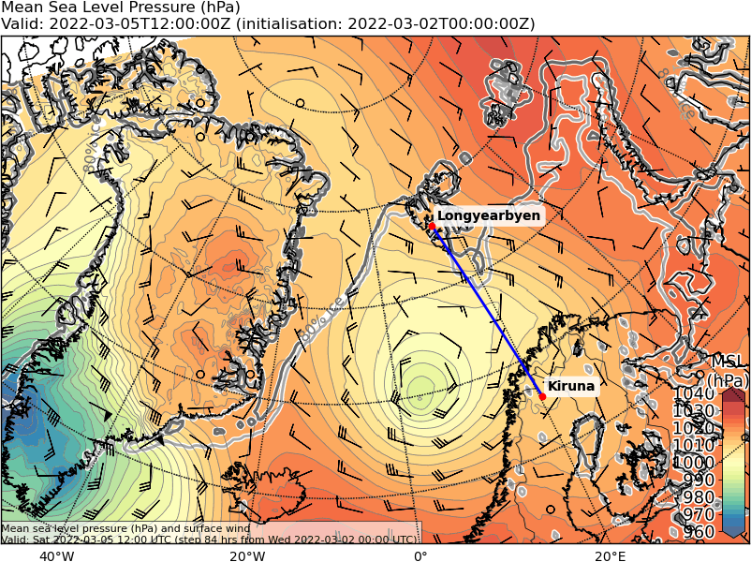
Saturday, 2022-03-05 12 UTC (+84h)
500 hPa Geopot & T
Sea level pressure
Notes:
low (now S of Svalb) weakens, south-easterlies around Svalbard (except Fram Strait)
precip south of Sv. and in a stripey convergence zone in Fram Strait
High NW of Sv remains → SE winds over Svalbard
High over Greenland

Slide 15
Surface wind development 2022-03-02 00 UTC: 00 – 72h ECMWF
L: Low H: High CAA: Cold Air Advection WAA: Warm Air Advection

Slide 16
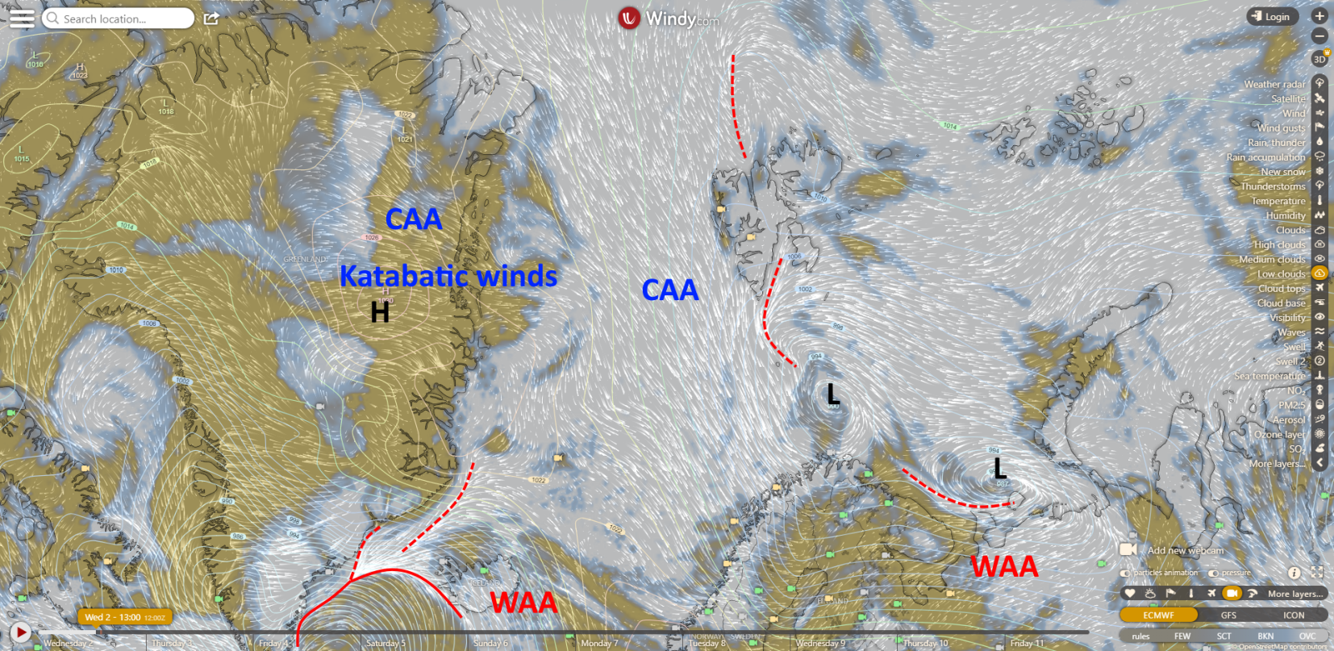
Wednesday, 2022-03-02 12 UTC (+12h)

Slide 17
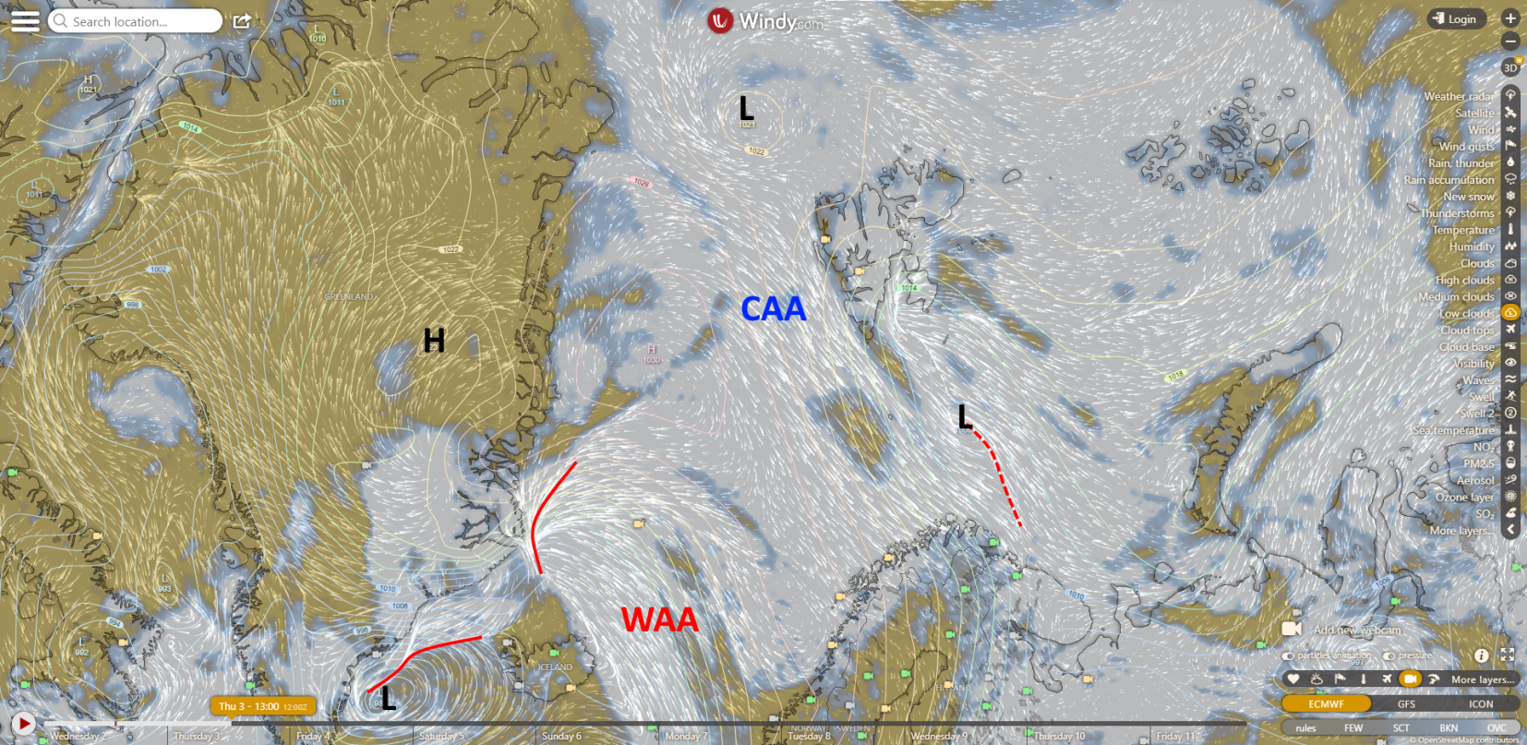
Thursday, 2022-03-03 12 UTC (+36h)

Slide 18
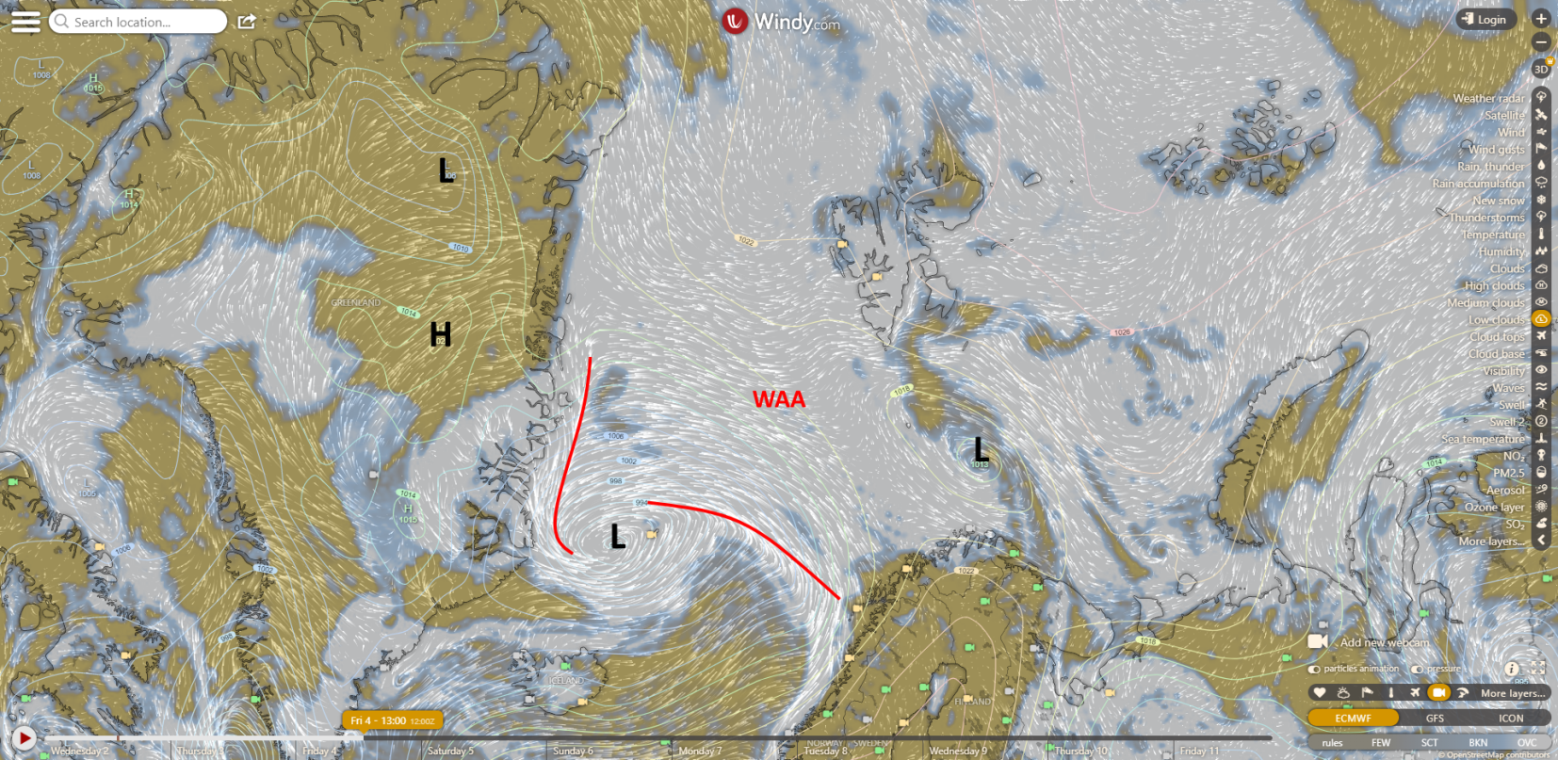
Friday, 2022-03-04 12 UTC (+60h)

Slide 19
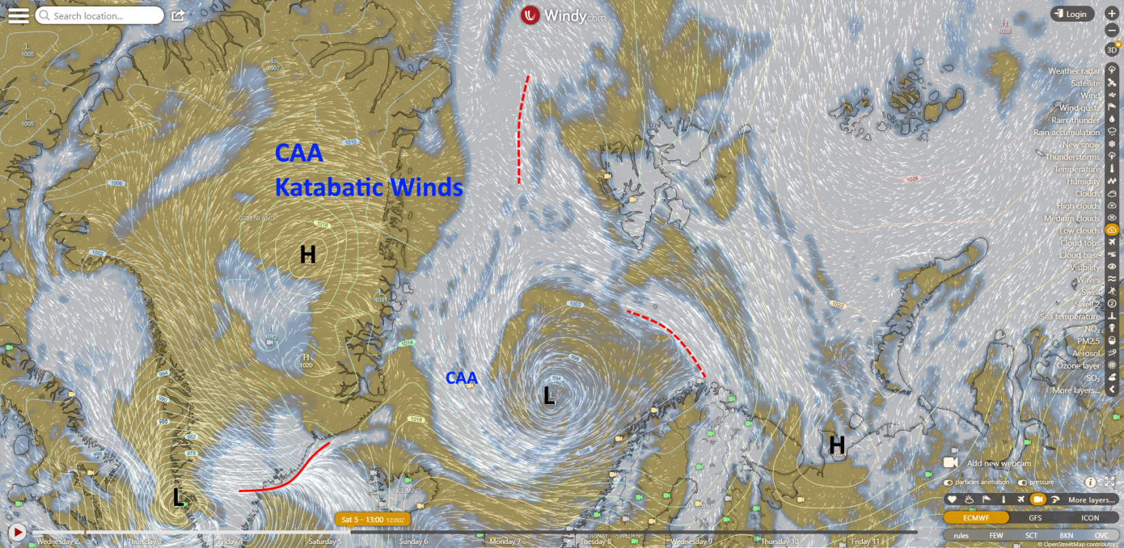
Saturday, 2022-03-05 12 UTC (+84h)

Slide 20
Cloud cover & precip development 2022-03-02 00 UTC: 00 – 84h ECMWF + ICON

Slide 21
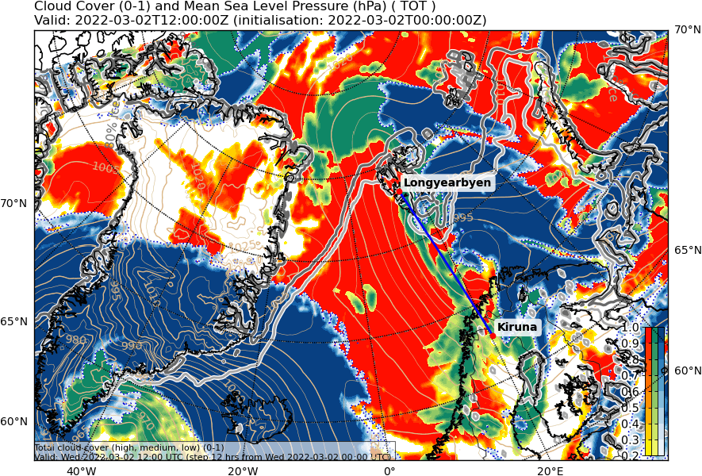
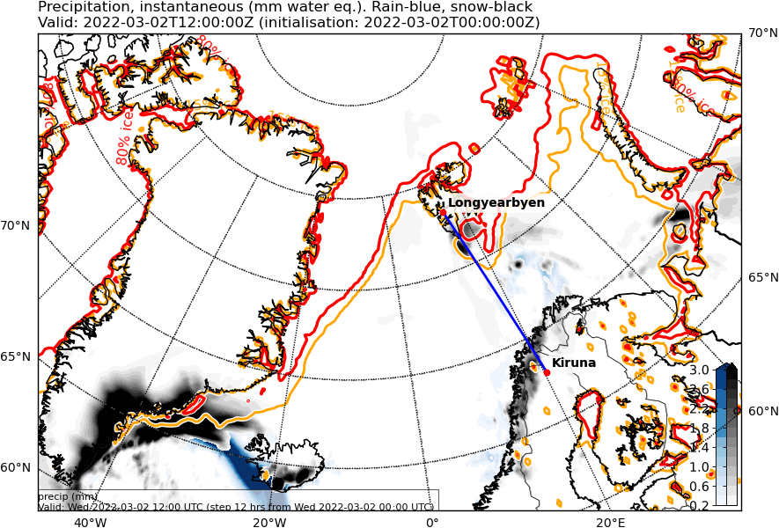
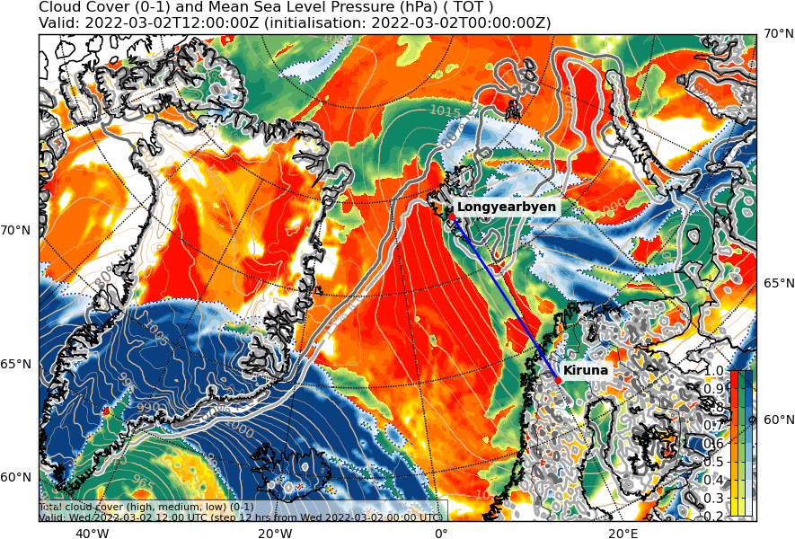
Wed, 2022-03-02 12 UTC (+12h)
ECMWF
Cross section; most likely F.S.,
else: where interesting stuff happens
not available
ICON

Slide 22
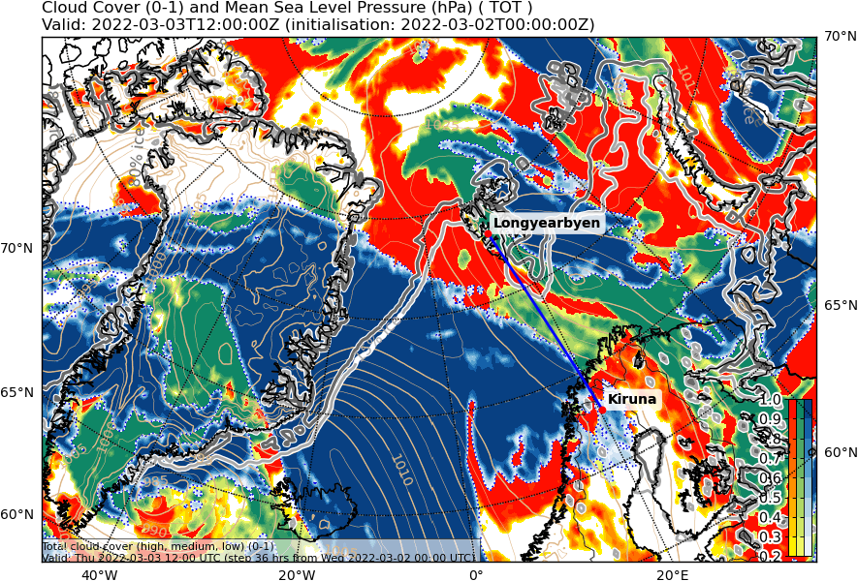
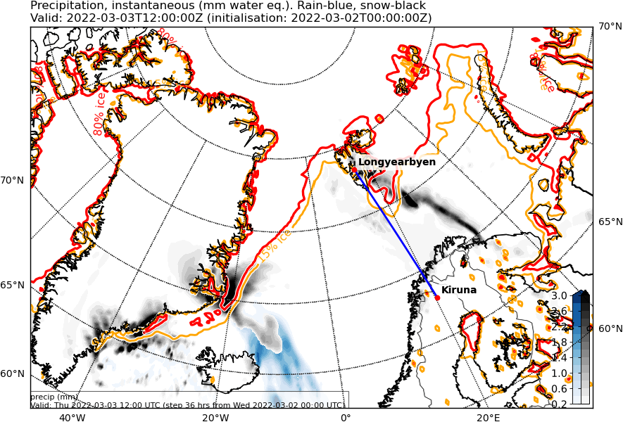
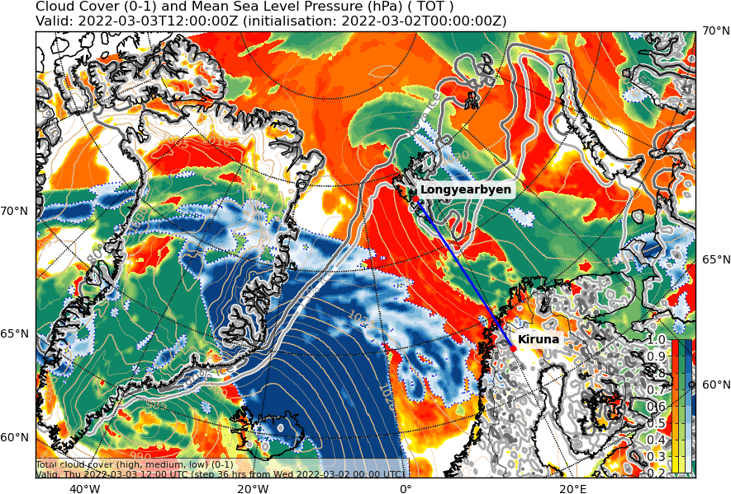
Thu, 2022-03-03 12 UTC (+36h)
ECMWF
not available
ICON

Slide 23
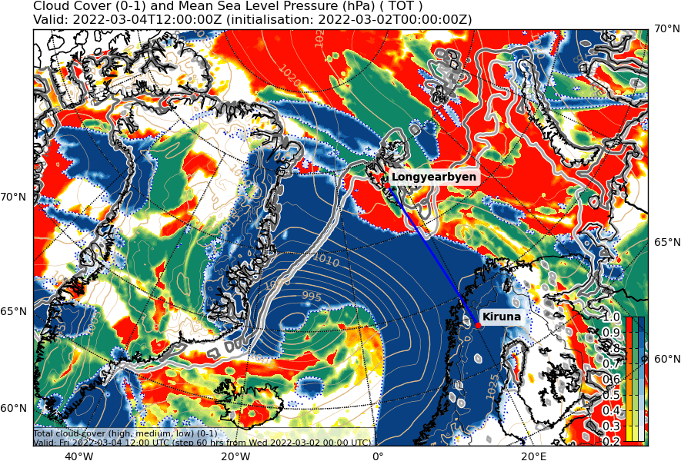
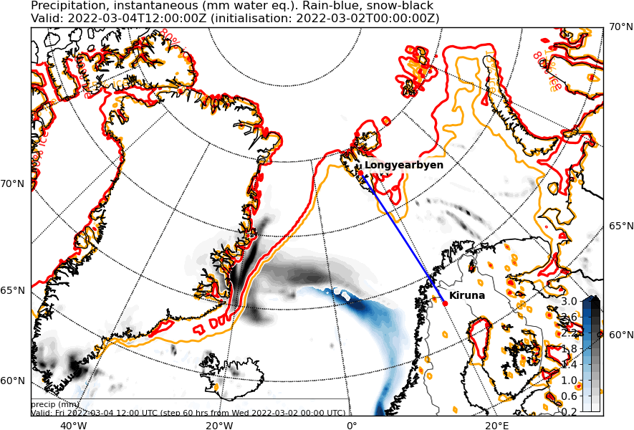
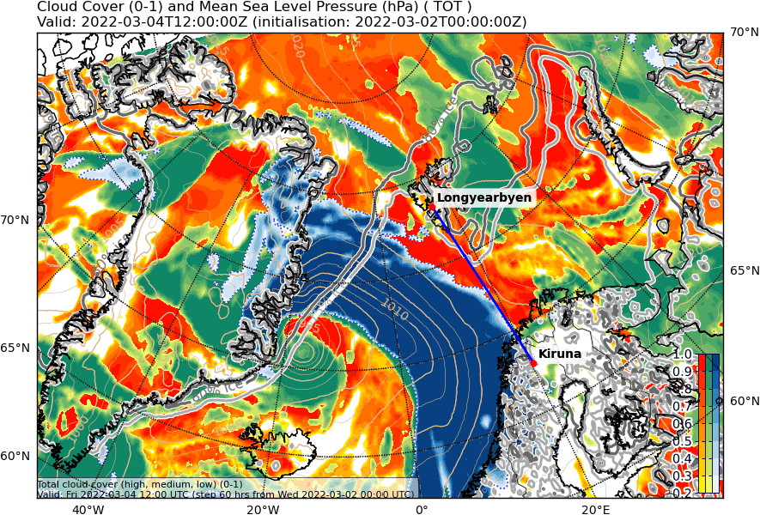
Fri, 2022-03-04 12 UTC (+60h)
ECMWF
not available
ICON

Slide 24
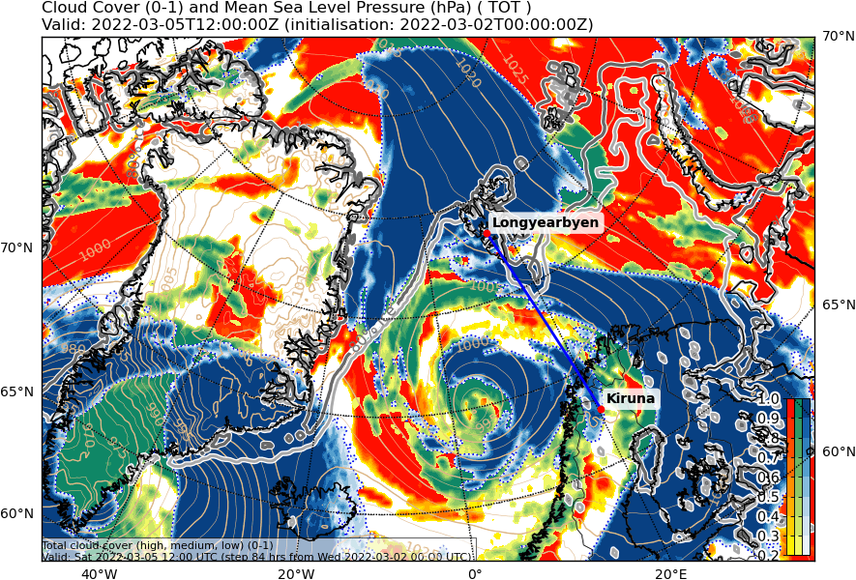
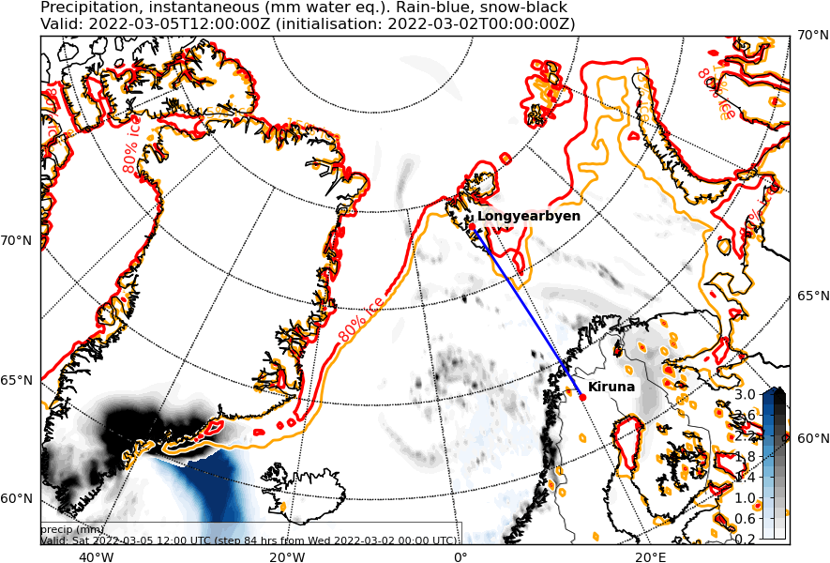
Sat, 2022-03-05 12 UTC (+84h)
ECMWF
not available
ICON

Slide 25
Extra variables 2022-03-02 00 UTC: 00 – 84h 500 hPa wind & 850hPa θ_{e} & CAO & IVT

Slide 26
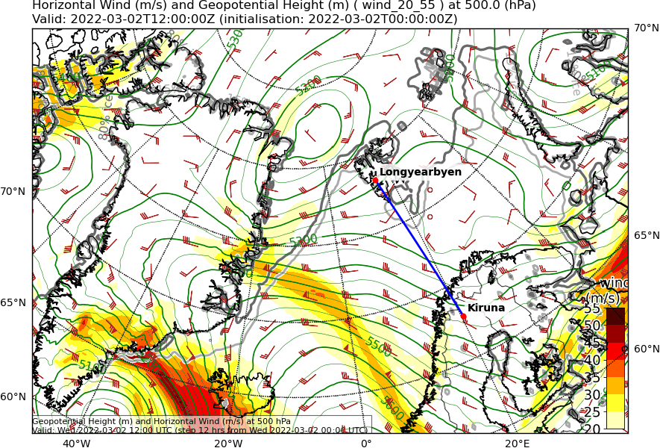
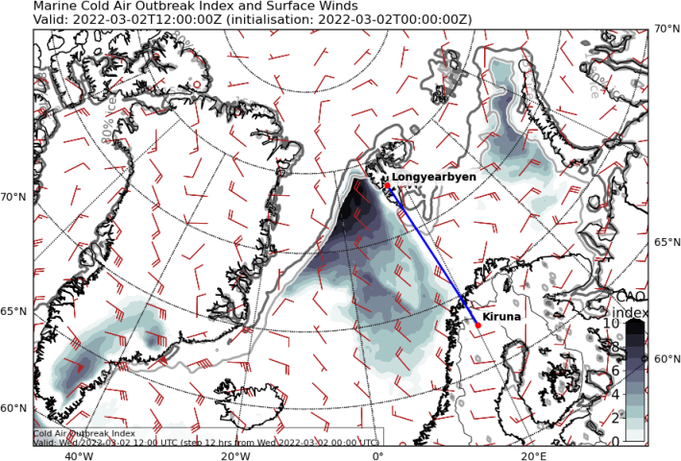
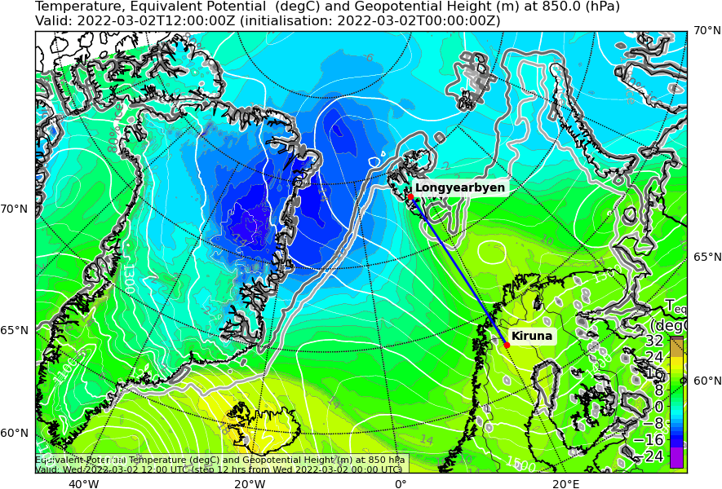
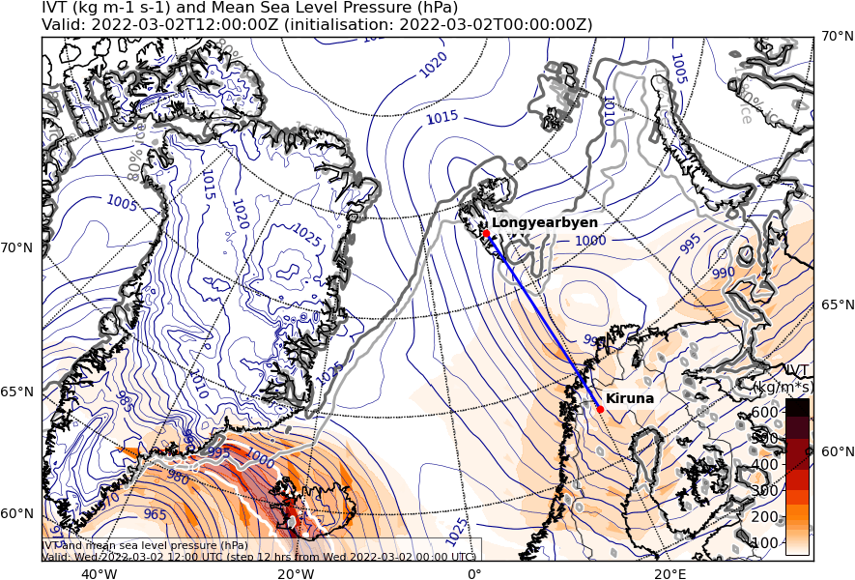
Wed, 2022-03-02 12 UTC (+12h)
500 hPa Geopot. and Wind
CAO Index
850 hPa Equiv. pot. temperature
Integrated water vapour transport
Notes:
850 hPa theta_e; 500 hPa geopot & wind;

Slide 27
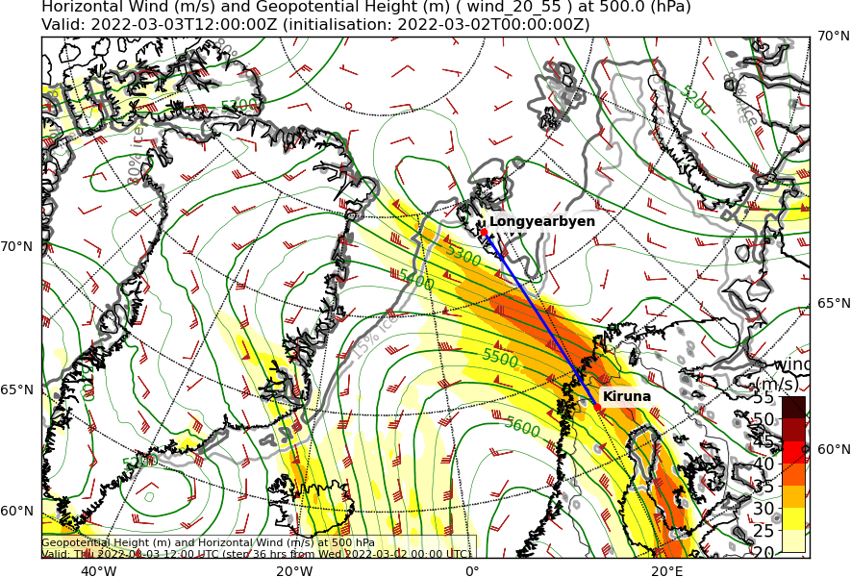
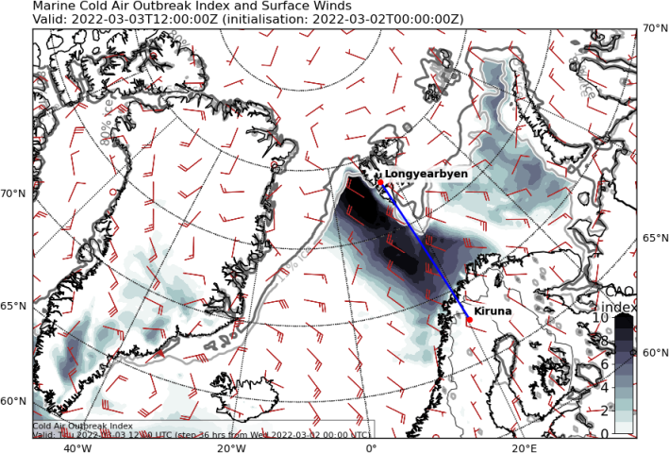
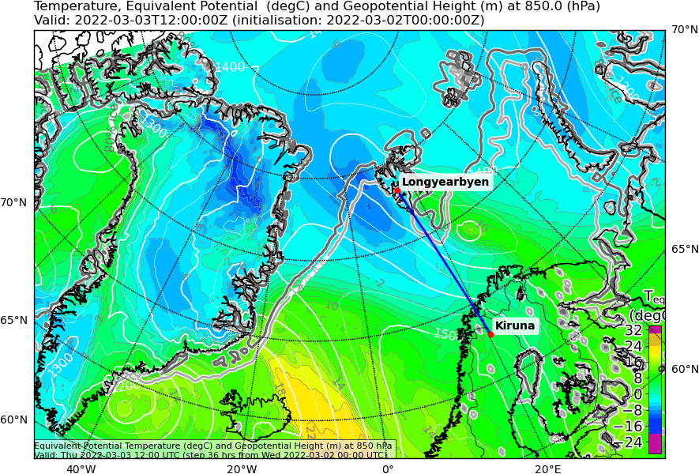
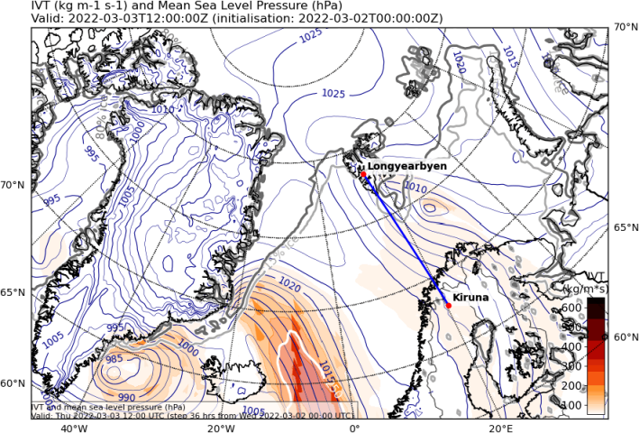
Thu, 2022-03-03 12 UTC (+36h)
500 hPa Geopot. and Wind
CAO Index
850 hPa Equiv. pot. temperature
Integrated water vapour transport

Slide 28
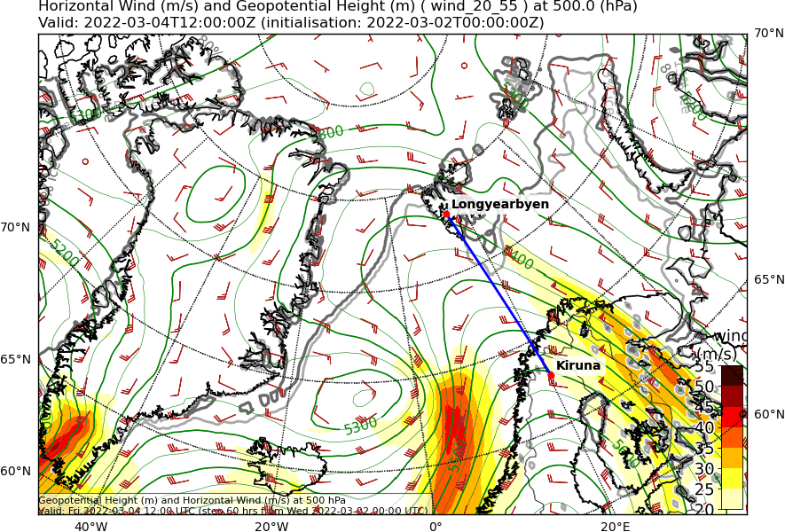
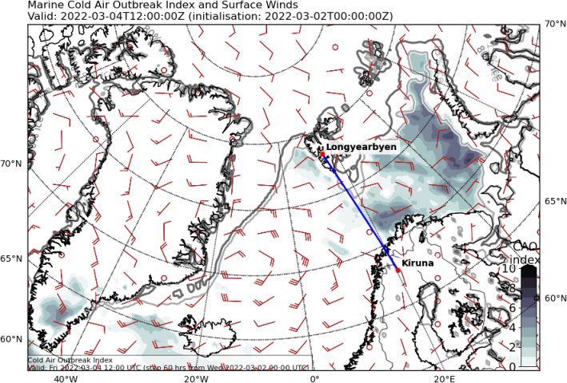
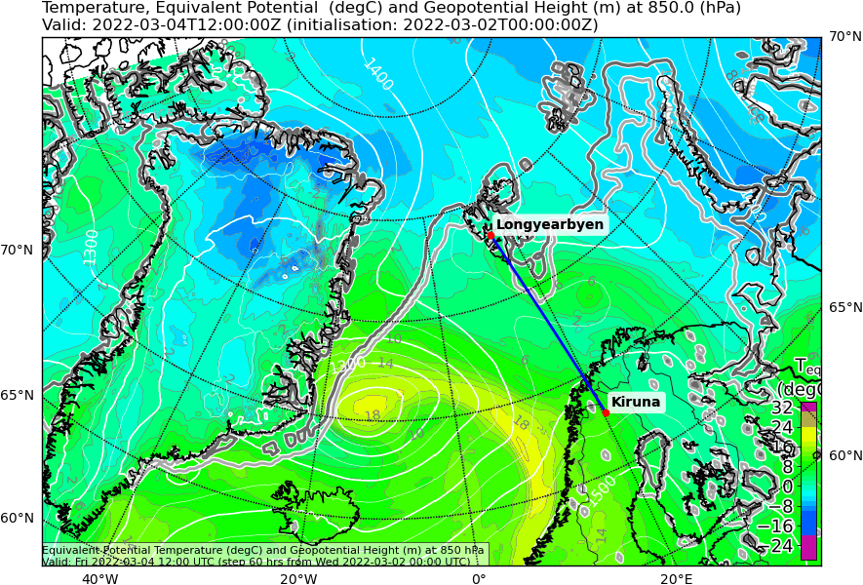
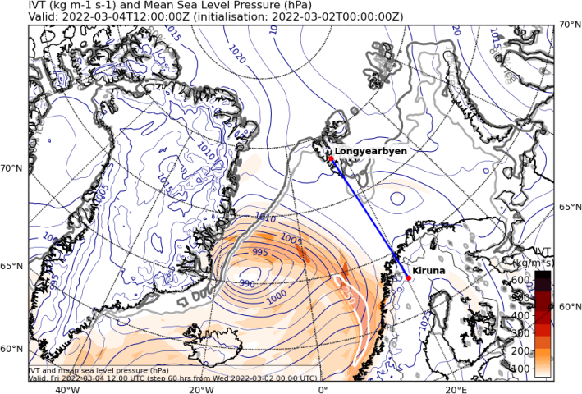
Fri, 2022-03-04 12 UTC (+60h)
500 hPa Geopot. and Wind
CAO Index
850 hPa Equiv. pot. temperature
Integrated water vapour transport

Slide 29
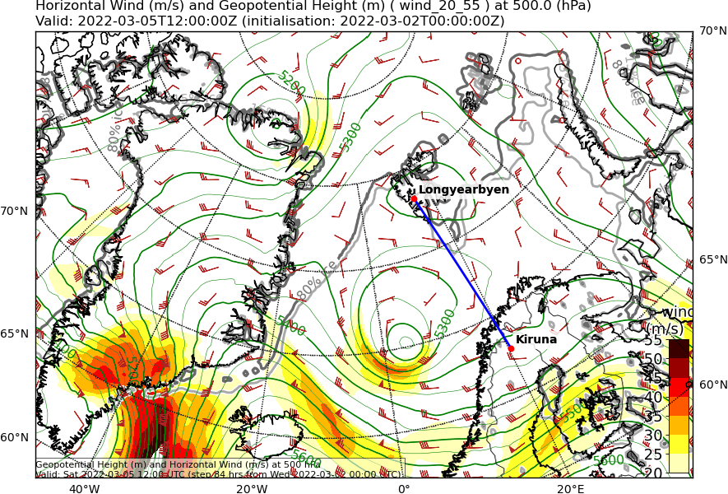
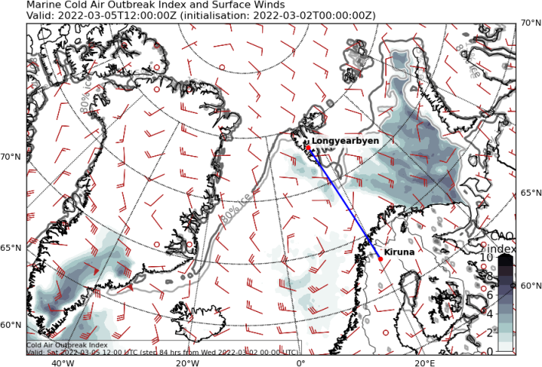
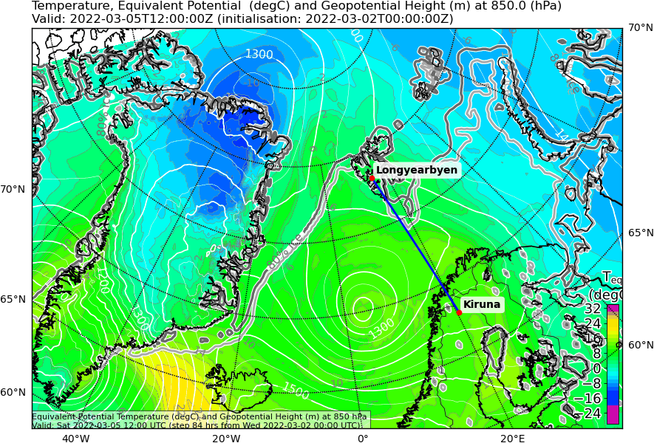
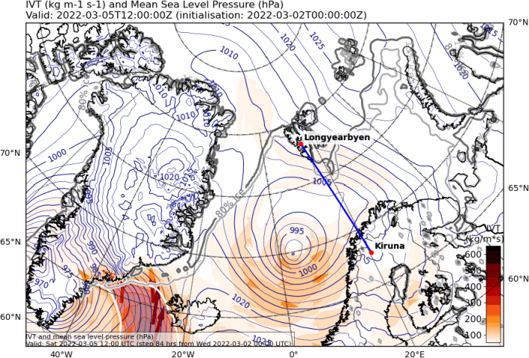
Sat, 2022-03-05 12 UTC (+84h)
500 hPa Geopot. and Wind
CAO Index
850 hPa Equiv. pot. temperature
Integrated water vapour transport

Slide 30
Airport meteograms 2022-03-02 00 UTC: 00 – 72h

Slide 31
Kiruna:
might look slightly different in the future

Slide 32
Longyearbyen:
will be available soon

Slide 33
Forecast uncertainty 2022-03-02 00 UTC: 72 – 96h

Slide 34
Saturday, 2022-03-05 00 UTC (+72h)
500 hPa Geopot
Sfc pressure
gpdam
hPa
Notes:
core pressure of Low between Sv and Iceland still uncertain (might develop deeper or shallower), general wind pattern should be the same because POSITION seems pretty certain (just intensity is uncertain)

Slide 35
Sunday, 2022-03-06 00 UTC (+96h)
500 hPa Geopot
Sfc pressure
gpdam
hPa
Notes:
dissolving phase and arrival of new ridge (with warm air) make things more uncertain

Slide 36
Summary

Slide 37
Summary: Weather Briefing 2022-03-02
Wednesday, 2022-03-02:
Cold Air Outbreak in Fram Strait
Katabatic winds from Greenland Ice sheet
Thursday, 2022-03-03:
Cold Air Outbreak in Fram Strait but its driver weakens
Friday, 2022-03-04:
Warm air (although a bit cooled) arrives in southern part of Fram Strait
Moderate moist air intrusion
Rather easterlies instead of southerlies
Saturday, 2022-03-05:
Dissolving low south of Svalbard
Slight cold air advection to its west

