Slide 3
Purpose of Test-Flight:
Wing by wing flight for UFA and SZ
Five-hole nose boom calibration pattern
Radar MW calibration, radiation pattern
Test of microphysical probes
Three flight segments

Slide 4
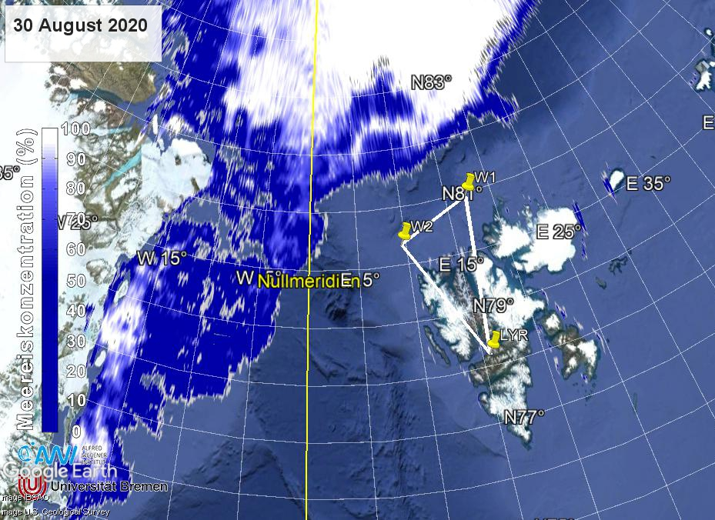
LYR → W1 Wing-by-wing flight for UFA and SZ
W2 ive-hole nose boom calibration pattern
W1 → W2 Radar/MW and Radiation calibration
W2 → LYR Test of microphysical probes
165 NM → 83 Min
83 NM → 42 Min
145 NM → 73 Min
198 Min
Plus 45 Min Nose-Boom Calibration

Slide 5
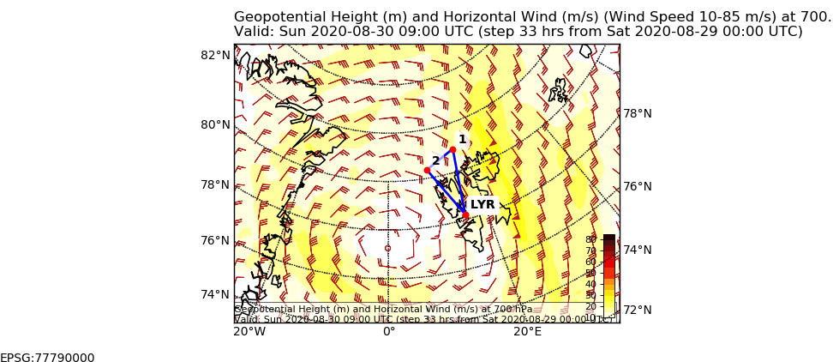
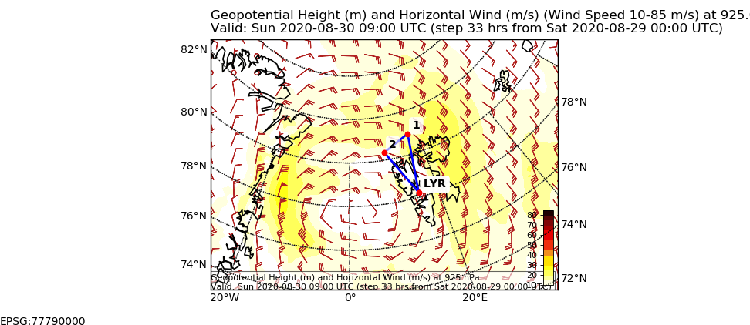
700 hPa
09 UTC
925 hPa
09 UTC

Slide 6
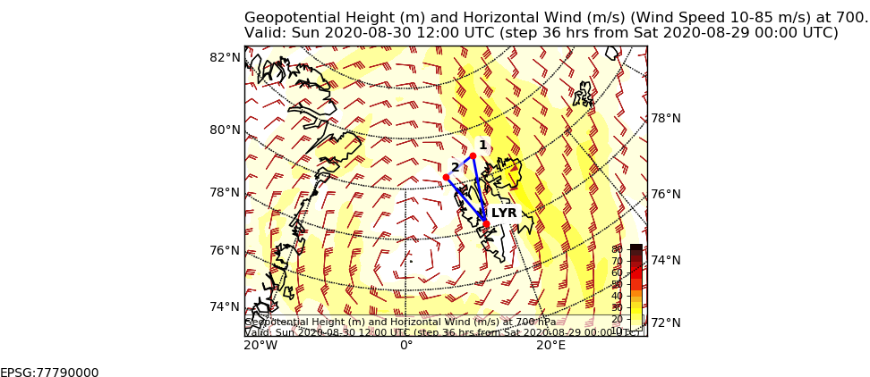
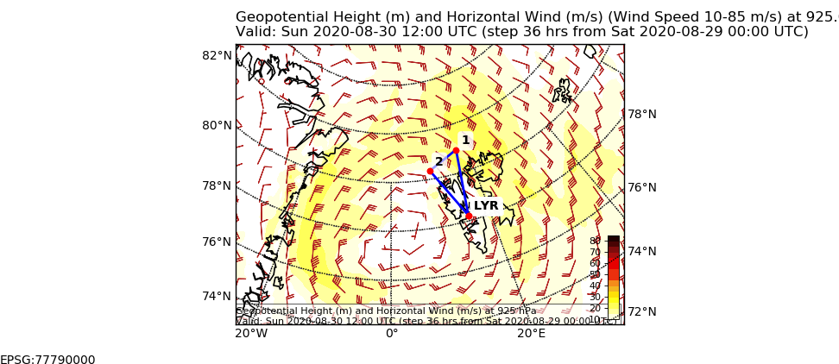
700 hPa
12 UTC
925 hPa
12 UTC

Slide 7
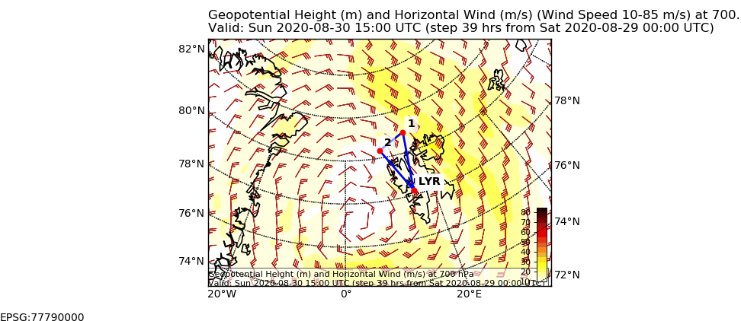
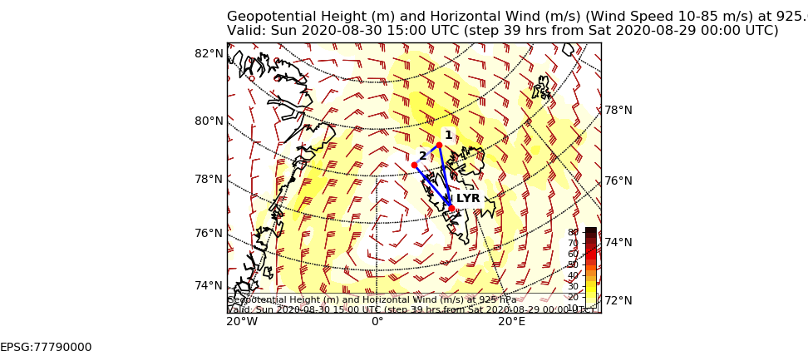
700 hPa
15 UTC
925 hPa
15 UTC

Slide 8
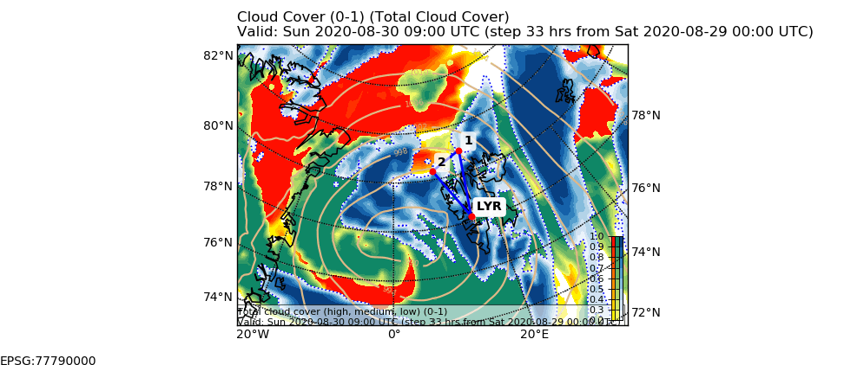
Clouds
09 UTC

Slide 9
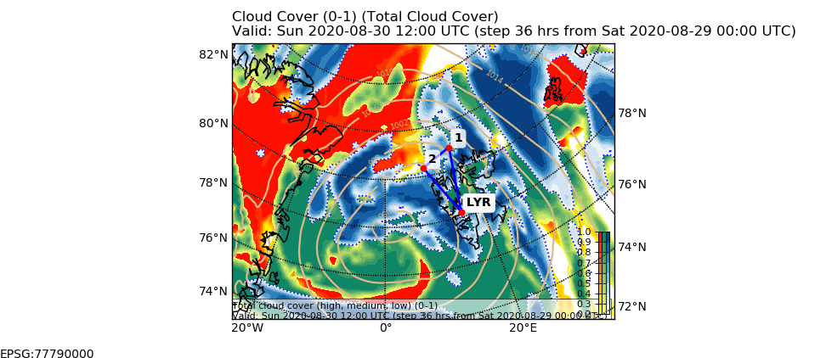
Clouds
12 UTC

Slide 10
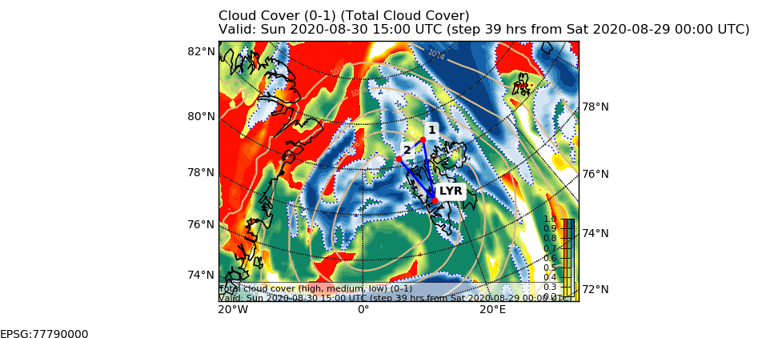
Clouds
15 UTC

Slide 11
POLAR 5
Remore Sensing
Flight Plan: MOSAiC ACA Flight 2019 03 30, Sunday
Est. Take Off: 09:00 LT
Crew: Mission PI Manfred Wendisch
AWI Martin Germann
PMS Manuel Moser
Radiation Michael Schäfer
Radar/MW/Lidar Mario Mech
Extra Seat Stephan Schön
Waypoints: LYR: 78° 14.816' N, 15° 27.545' E

Slide 12
Nose-boom + rad
calibration
Legs of 20 miles length
Drop sondes
After take-off climb to FL100
Coordinate with P6

Slide 13
Flight Plan P5
LYR → W1 climb and stay at 10,000 ft: 165 NM @ 120 kn 83 min
In coordination with P6
W1 – Nose-boom/rad calib 4 times 20 NM @ 120 kn 45 min
W1 – W2 Radar/MW calibration 83 NM @ 120 kn 73 min
W2 → LYR 145 NM @ 120 kn 73 min
In coordination with P5
Total: 473 NM 236 min

Slide 15
Patterns for calibration: Noseboom
During each flight there should be one section where the same
Leg of 5 min length is flown in opposite direction.
More such legs → better accuracy of our wind measurement
5 minutes
This can be flown below clouds, or in clouds
Also possible at high levels (e.g. 10.000 ft) on our way home

Slide 16
Patterns for calibration: Noseboom
To be flown only one time during the campaign:
2 min-legs with different speed (TAS) (parallel to wind)
80 Kn
100 Kn
120 Kn
140 Kn
120 Kn
100 Kn
80 Kn
60 m above surface
Closed Sea Ice

Slide 17
Patterns for calibration: Radiation
Radiation Square
1-2 min edge length
First leg should be oriented towards the sun

Slide 18
Some Definitions
Temp (fast): ascend from the lowest level to e.g. 3000 ft
with 2000 ft/min or, vice versa, descend
Temp (slow): ascend/descend rates of 100-200 ft/min
A temp should always reach
the lowest possible height above the surface

Slide 19
Some Definitions
Short turn: Long turn:

Slide 20
