Slide 1
Weather update HALO-(AC)³
Tuesday, 2022-03-08, 09:00 LT

Slide 2
Forecast comparison yesterday 00 UTC vs. 12 UTC

Slide 3
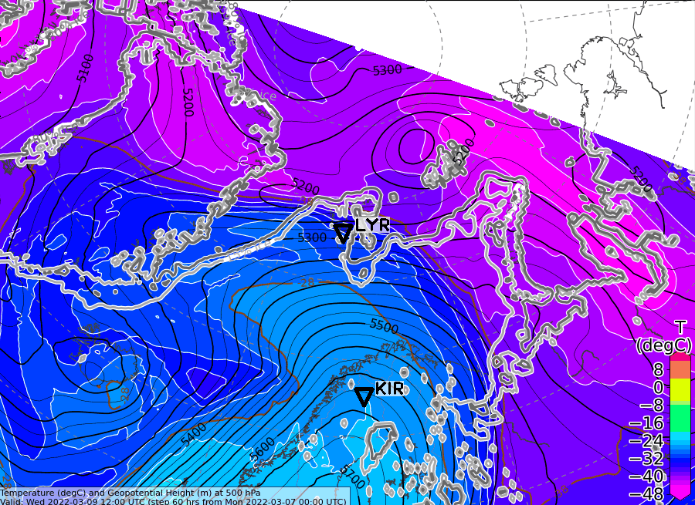
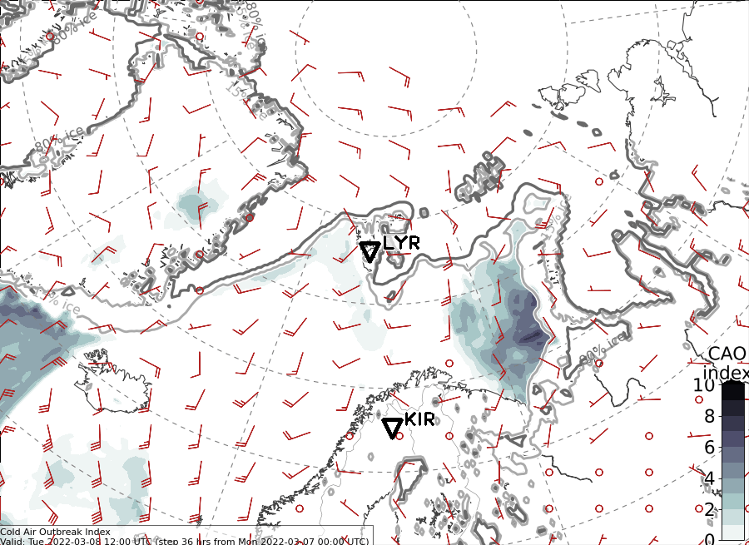
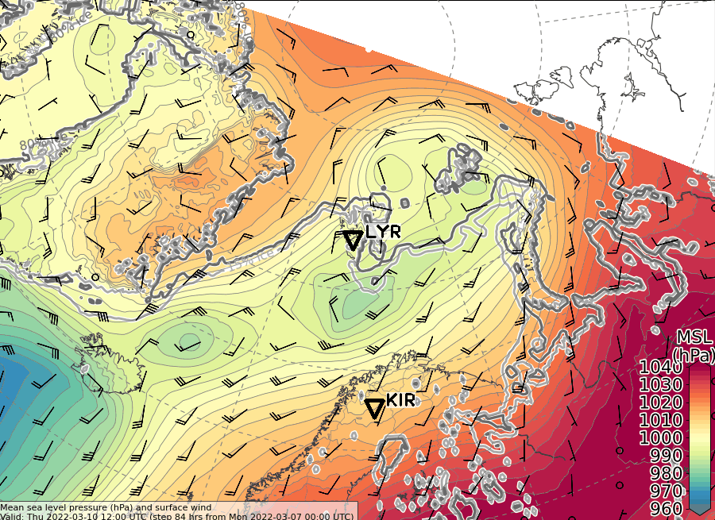
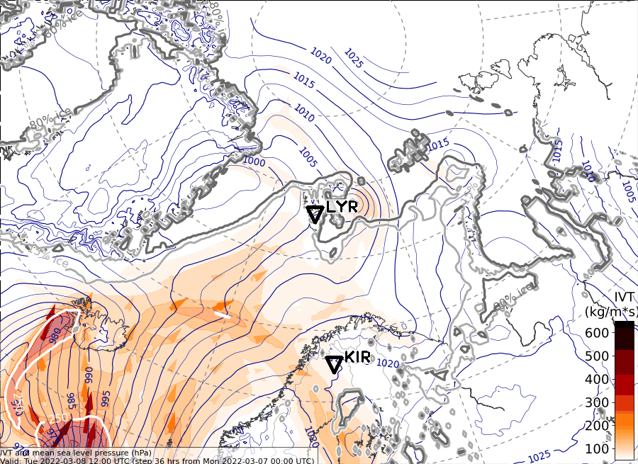
Thu, 2022-03-10 12 UTC (+60h)
500 hPa Geopot. and T (yest. 00UTC)
500 hPa Geopot. and T (ECMWF today)
Sea level pressure (ECMWF yest.)
Sea level pressure (ECMWF today)

Slide 4
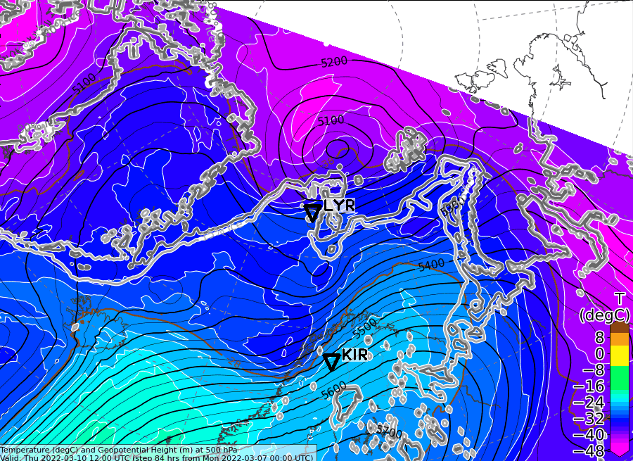
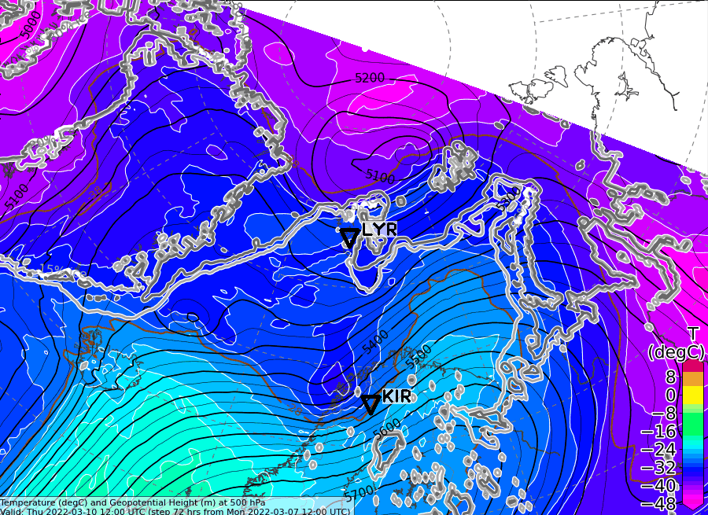
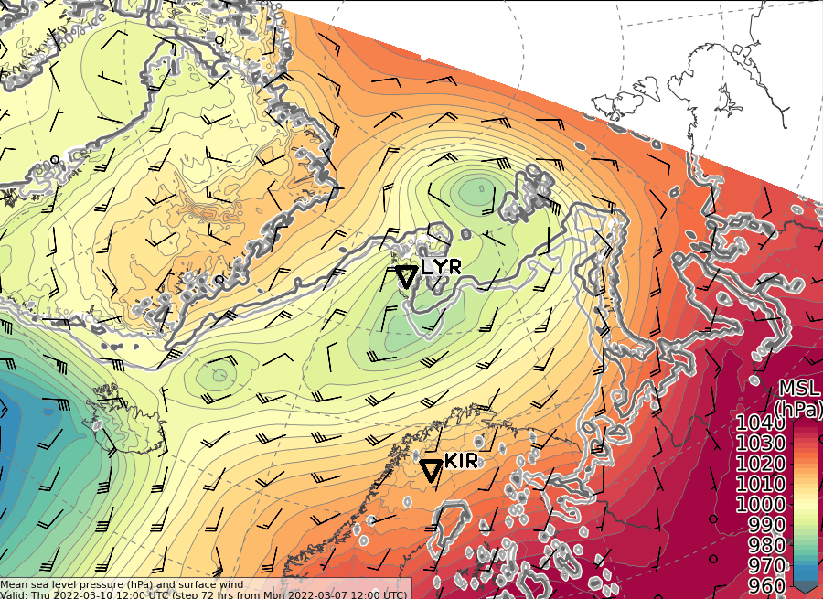
Thu, 2022-03-10 12 UTC (+60h)
500 hPa Geopot. and T (yest. 00 UTC)
500 hPa Geopot. and T (yest. 12 UTC)
Sea level pressure (yest. 00UTC)
Sea level pressure (yest. 12 UTC)
L
L
L
L
L
L
L

Slide 5
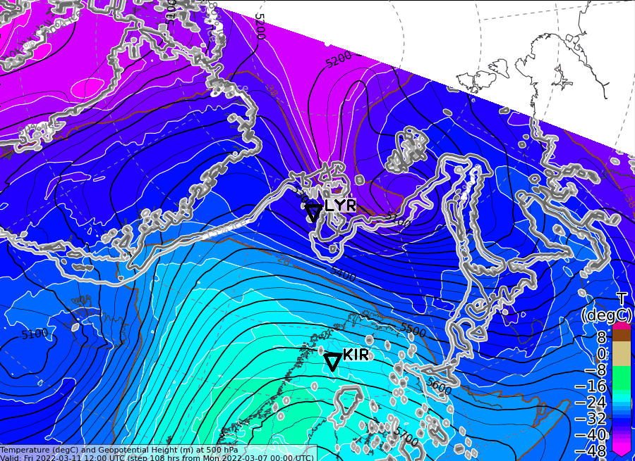
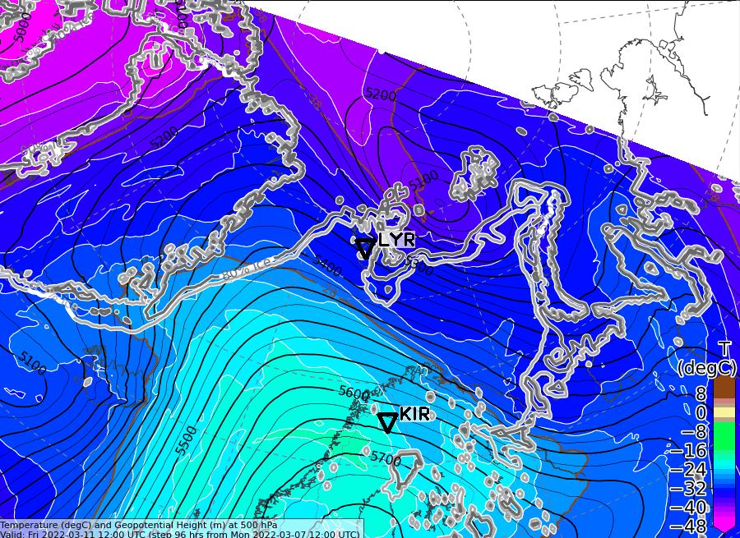
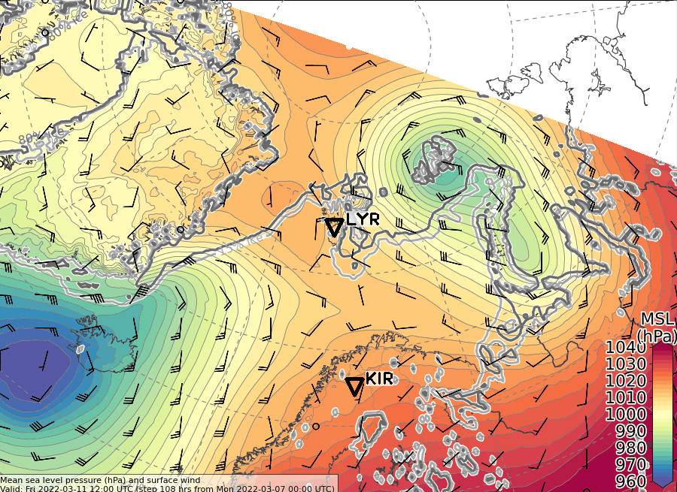
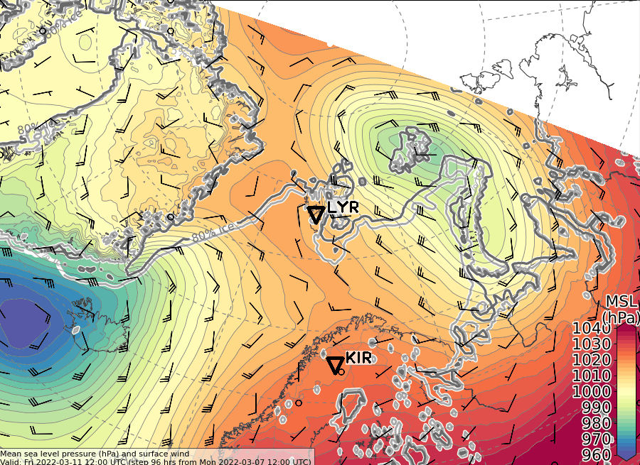
Fri, 2022-03-11 12 UTC (+84h)
500 hPa Geopot. and T (yest. 00 UTC)
500 hPa Geopot. and T (yest. 12 UTC)
Sea level pressure (yest. 00 UTC)
Sea level pressure (yest. 12 UTC)
L
L
H
L
L
L
L

Slide 6
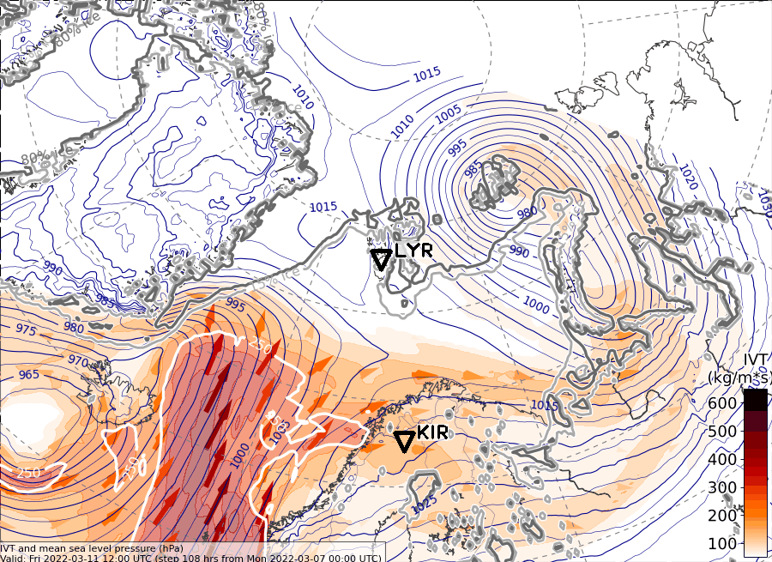
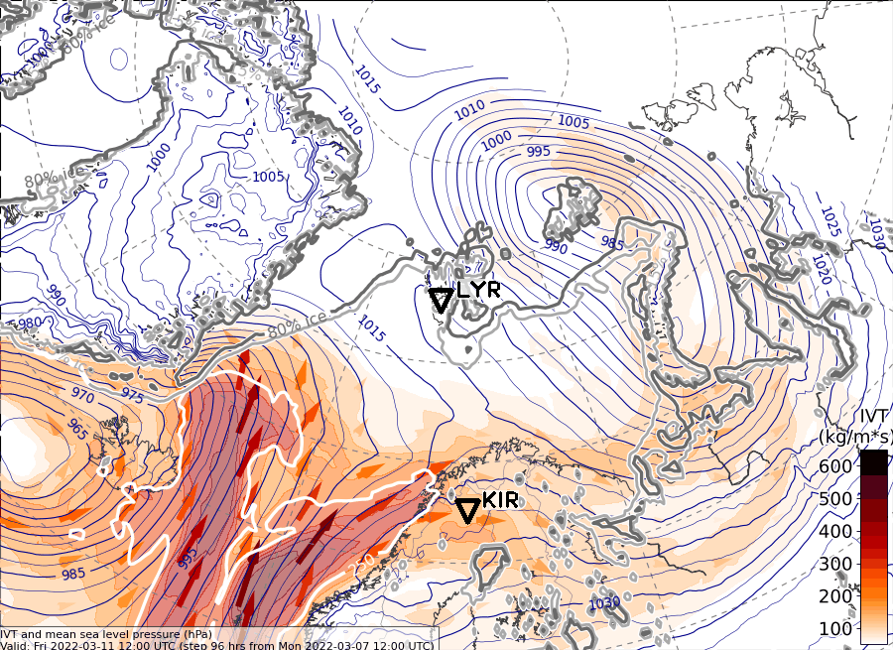
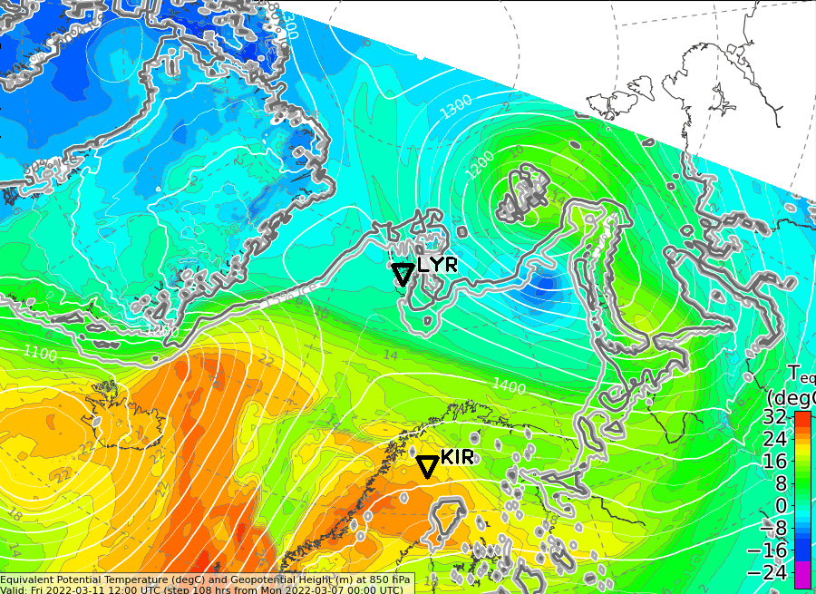
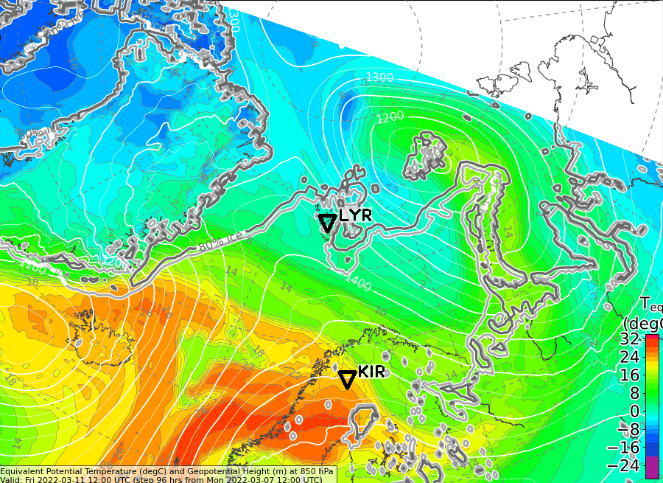
Fri, 2022-03-11 12 UTC (+84h)
IVT (yest. 00 UTC)
IVT (yest. 12 UTC)
850 hPa Equiv. pot. T (yest. 00 UTC)
850 hPa Equiv. pot. T (yest. 12 UTC)

Slide 7
Detailed outlook for Friday & Saturday 2022-03-07 12 UTC: 90h - 120h 500 hPa Geopot & T Sea level pressure

Slide 8
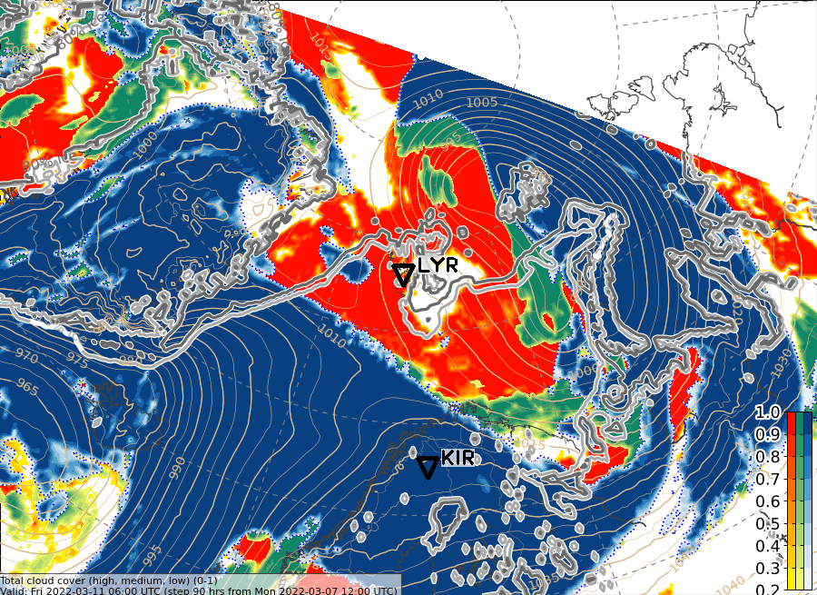
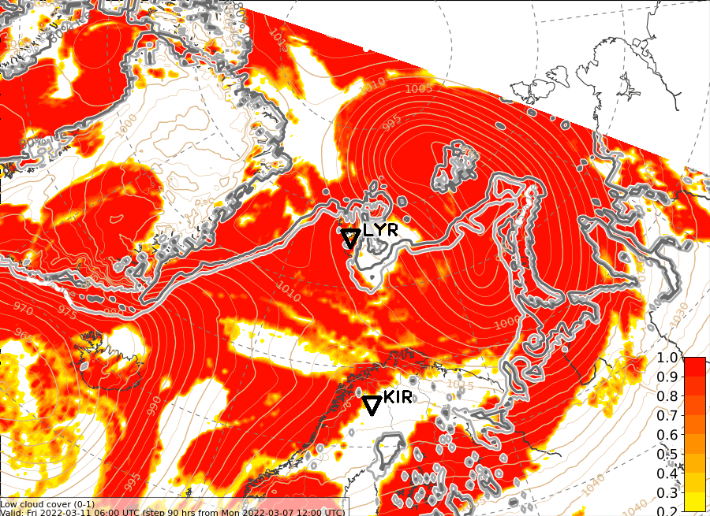
Fri, 2022-03-11 06 UTC (+90h)
ECMWF Total CC
ECMWF Low CC

Slide 9
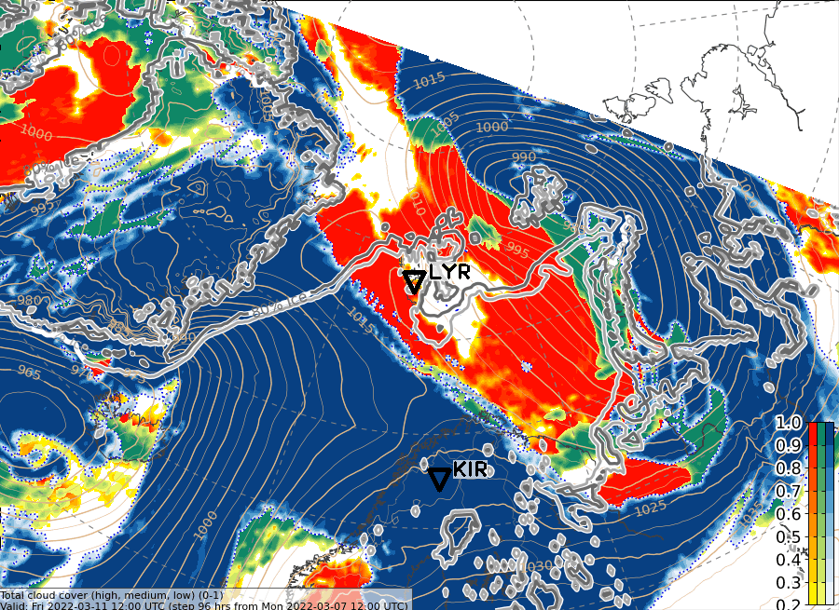
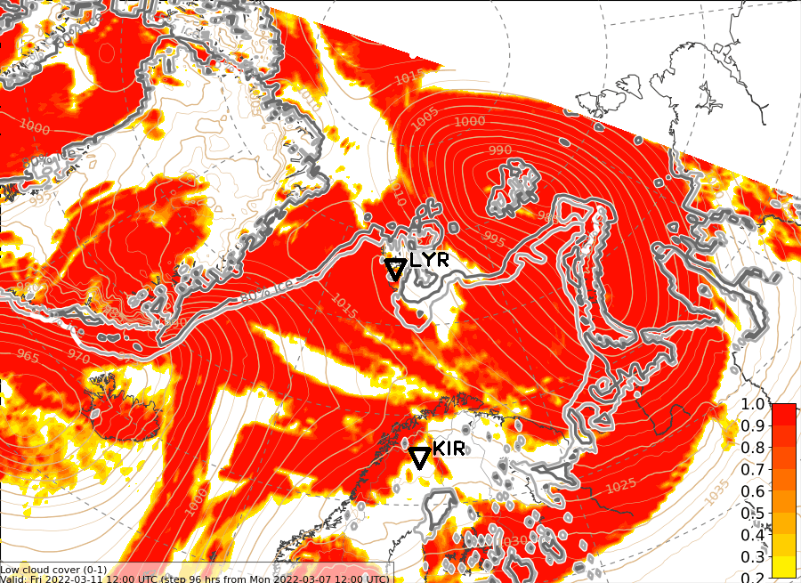
Fri, 2022-03-11 12 UTC (+96h)
ECMWF Total CC
ECMWF Low CC

Slide 10
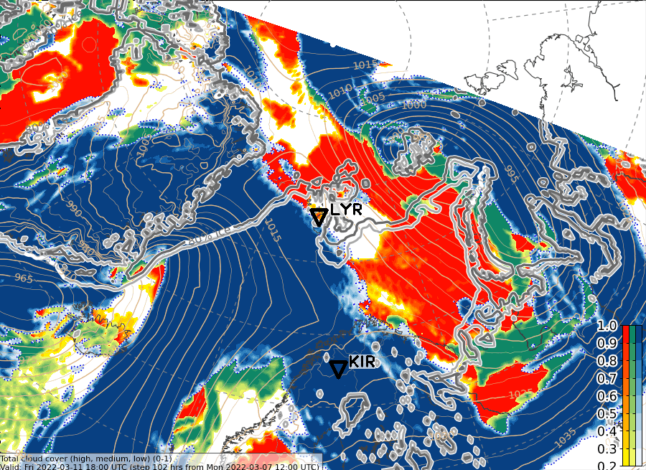
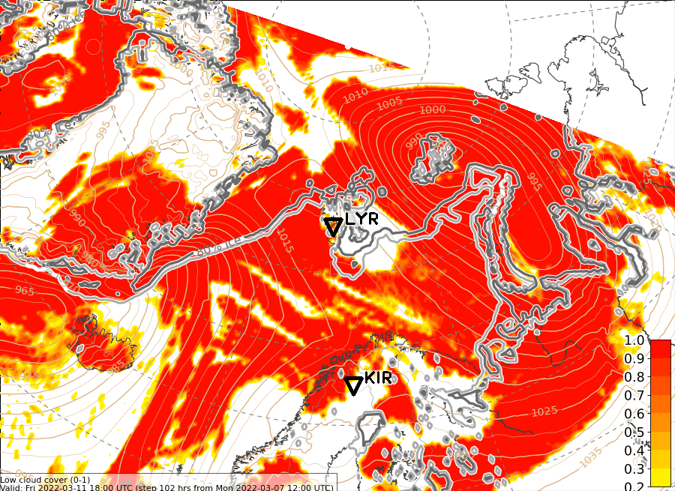
Fri, 2022-03-11 18 UTC (+102h)
ECMWF Total CC
ECMWF Low CC

Slide 11
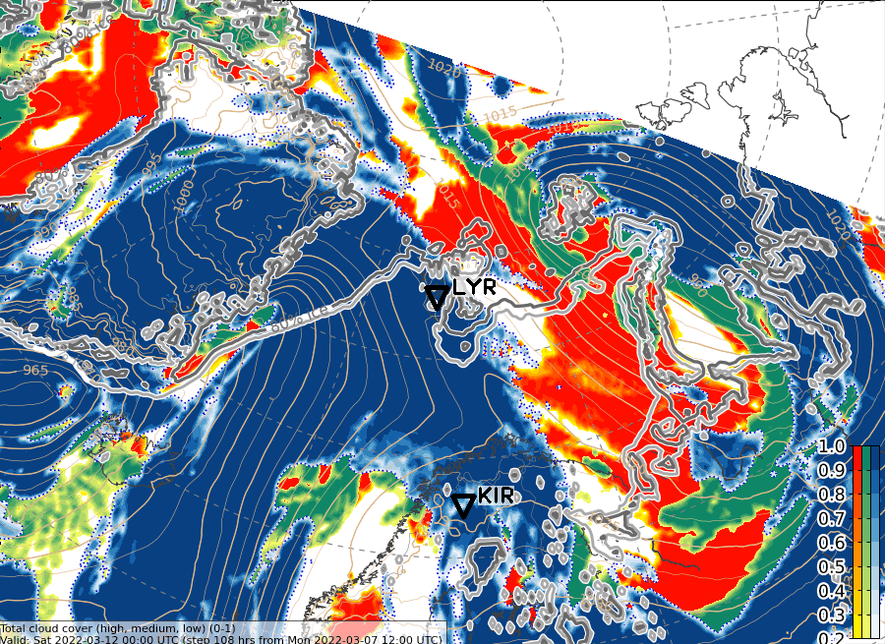
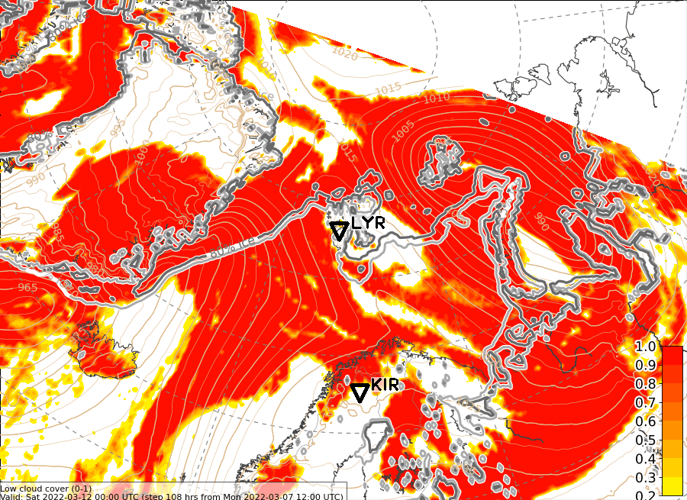
Sat, 2022-03-12 00 UTC (+108h)
ECMWF Total CC
ECMWF Low CC

Slide 12
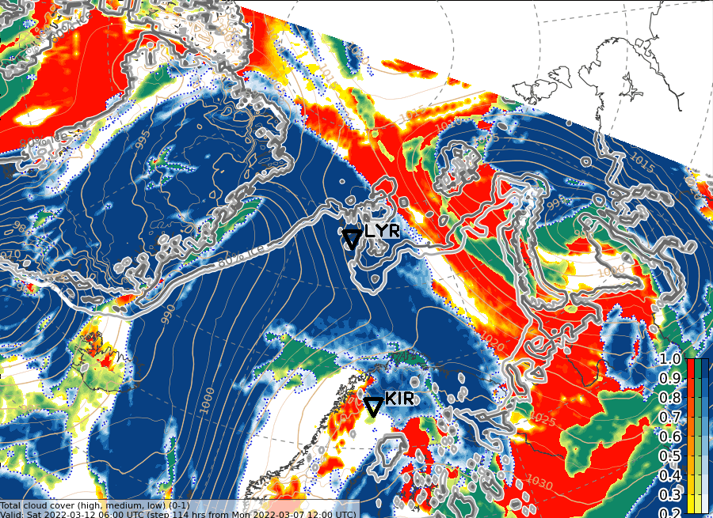
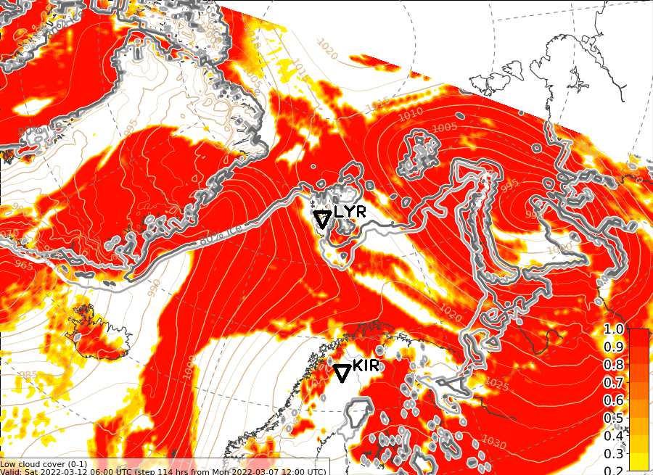
Sat, 2022-03-12 06 UTC (+114h)
ECMWF Total CC
ECMWF Low CC

Slide 13
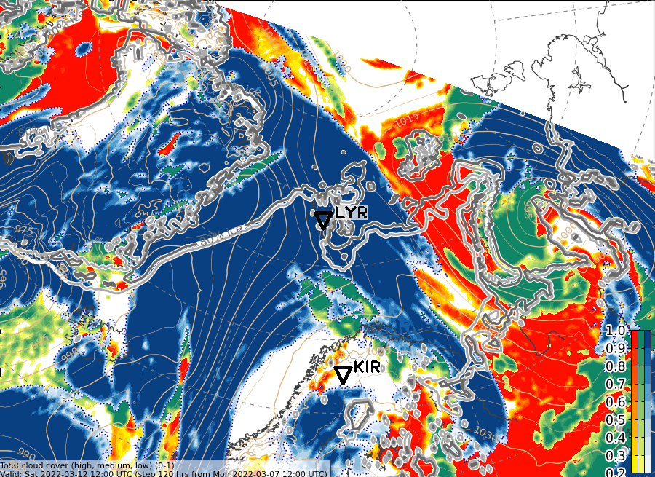
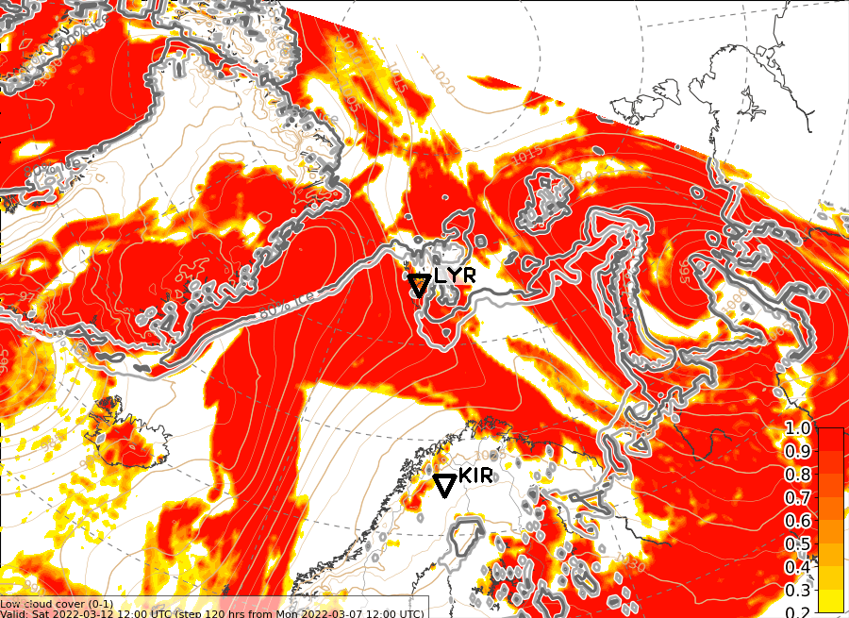
Sat, 2022-03-12 12 UTC (+120h)
ECMWF Total CC
ECMWF Low CC

Slide 14
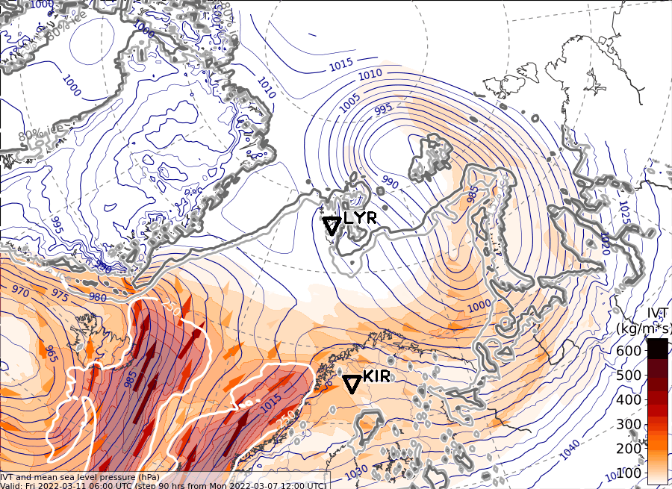
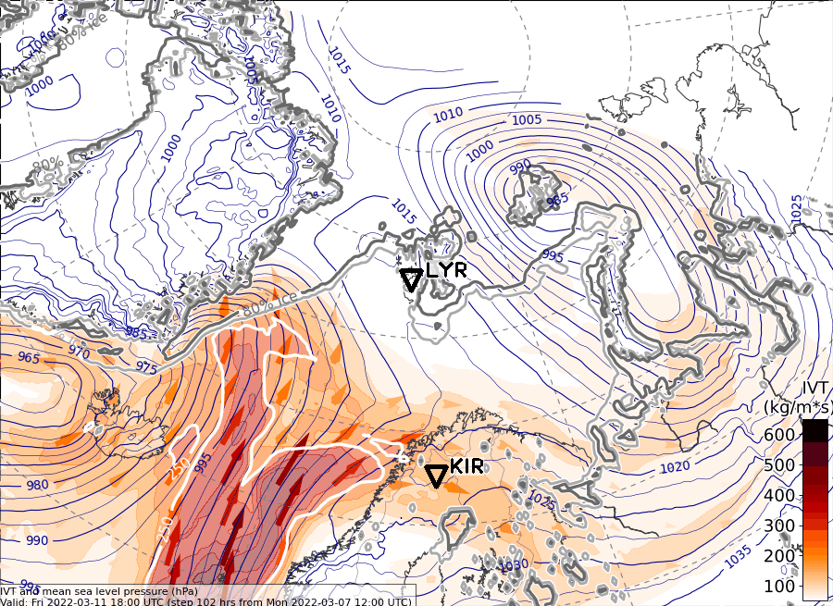
IVT, Fri, 2022-03-12
12 UTC
06 UTC
not available
18 UTC

Slide 15
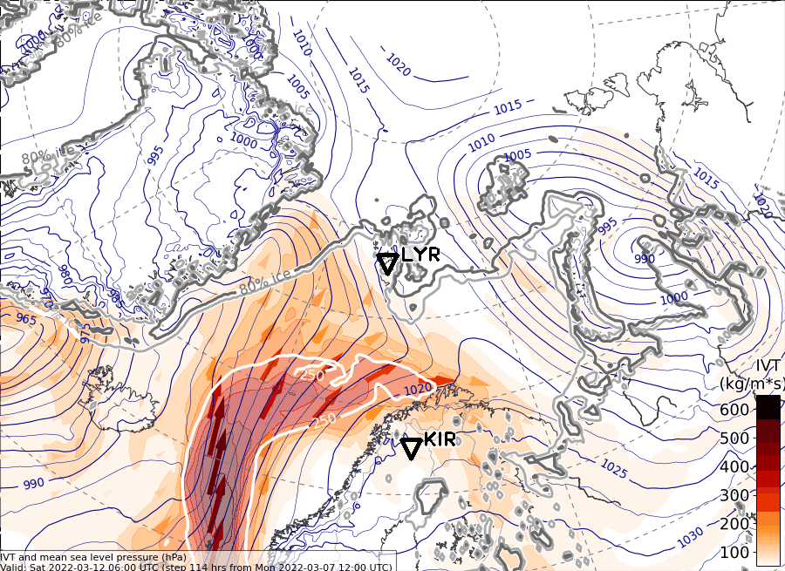
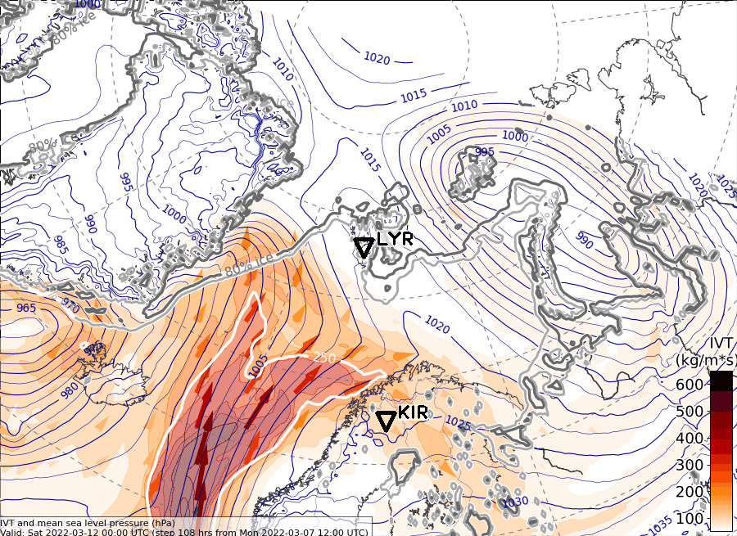
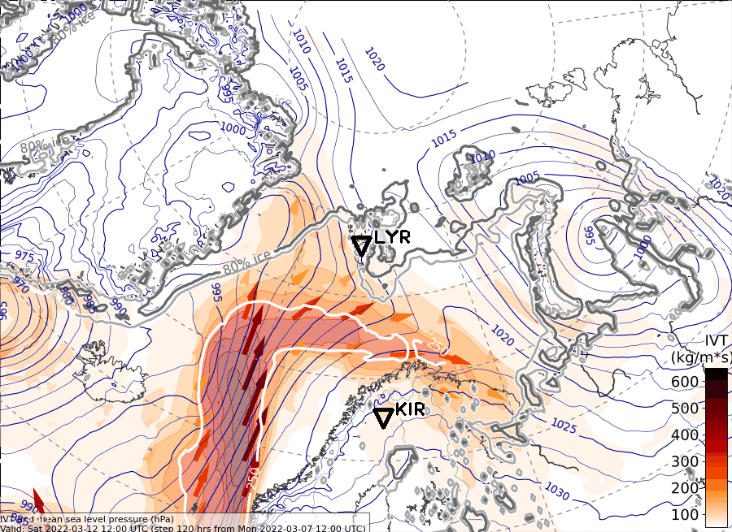
IVT, Sat, 2022-03-12
06 UTC
00 UTC
not available
12 UTC

Slide 16
Summary

Slide 17
Summary: Weather Update 2022-03-08, 09:00 LT
Thursday, 2022-03-10:
Weak cold-air advection over Fram Strait also in latest forecast
Only slight changes in pattern
Friday, 2022-03-11:
High pressure ridge over Fram Strait slightly more amplified
Warm and moist air intrusion a bit more pronouced than in yesterday 00 UTC forecast
One part into Fram strait towards sea ice and another one towards Barents Sea
Saturday, 2022-03-12:
Warm and moist air intrusion reaches Fram Strait
Slightly increased values of IVT also over sea ice in Fram Strait

