Slide 1
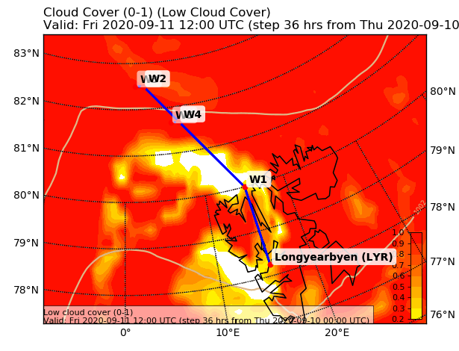
?? March 2021
Flight Plan for:
POLAR 5
Take Off: ??:?? UTC
Duration: ??.?? Hours
Pilots:
??
??
Crew:
Mission PI ??
AWI ??
AWI ??
Eagle/Hawk ??
MiRAC ??
PMS ??
Waypoints:
W1: 80° 00' N, 15° 00' E
W2: 82° 30' N, 3° 00' E
W3: 82° 30' N, 1° 20' E
W4: 81° 40' N, 8° 00' E
W5: 81° 40' N, 6° 48' E
Overview Map:

Slide 2
?? March 2021
Flight Plan for:
POLAR 5
Detailled Map:
Drop Sonde
Flight Plan (including drop sondes):
LYR – W1 ascend FL 100: 105 NM @cruising speed 40 min
W1 – W2 at FL 100: 185 NM @cruising speed 70 min
W2 – W3 descend to cloud top with 2,000 ft/min (inside cloud 500 ft/min) 15 min
W3 ←→ W2 different levels from below: 10 NM @120kn 40 min
W2 –W4 saw tooth trough clouds: 65 NM @140kn 35 min
W4 ←→ W5 different levels from below : 10 NM @120kn 40 min
W4 – W1 at FL100: 120 NM @ cruising speed 45 min
W1 – LYR at FL100 → descending: 105 NM @ cruising speed 40 min
Total: 5 hr 25 min

Slide 3
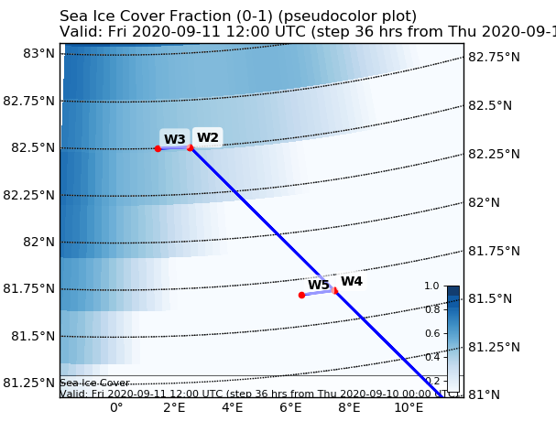
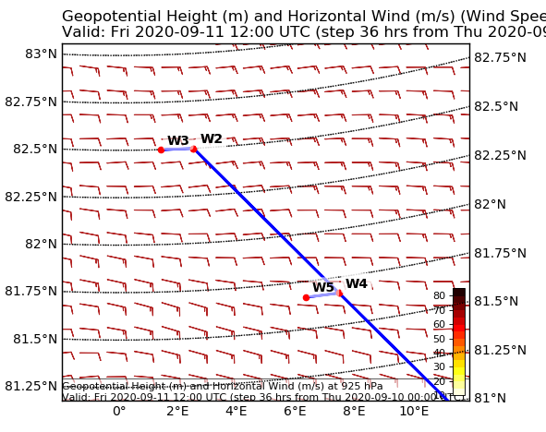
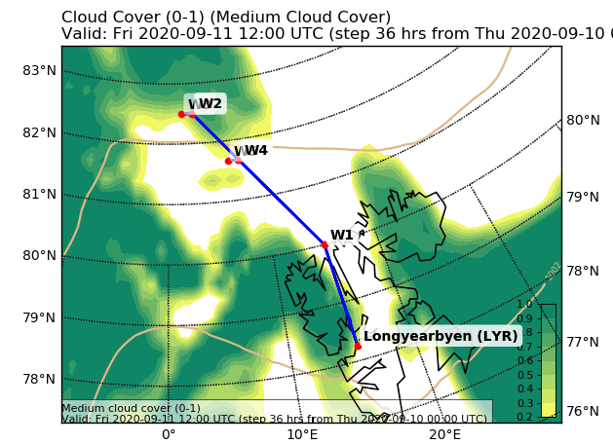
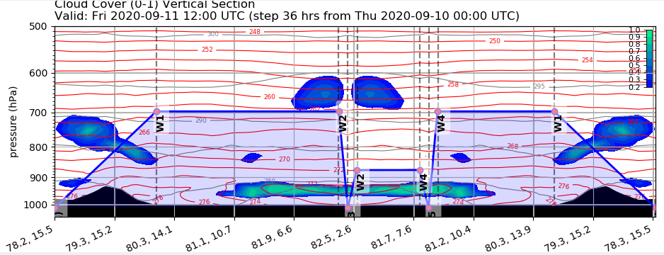
?? March 2021
Flight Plan for:
POLAR 5
Additional Maps:

Slide 4
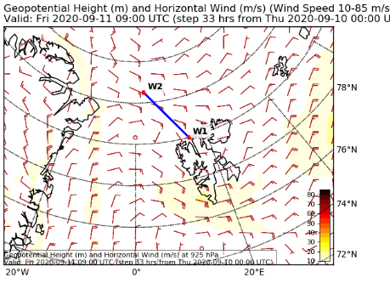
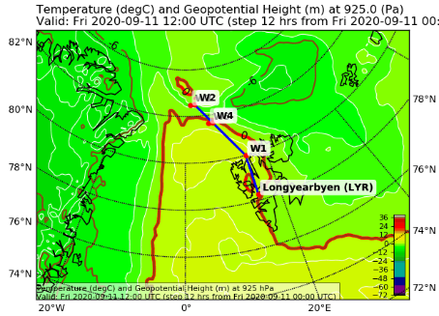
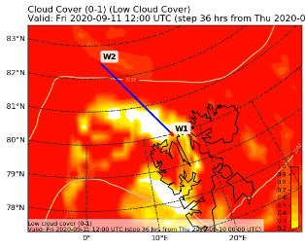
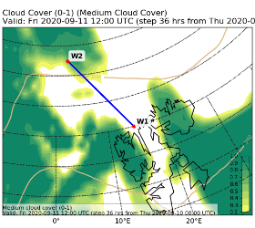
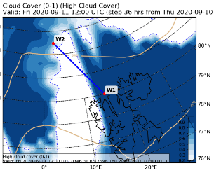
?? March 2021
Flight Plan for:
POLAR 5
Objectives of the Flight:
Characterize the lee effect of Svalbard on atmosphere and cloud conditions in south-easterly wind conditions by dropsonds and remote sensing. Profile multi-layer clouds over sea ice and over open ocean by in situ observations in different altitudes.
General Weather Situation:
Low pressure south of Svalbard caused a south-easterly flow around the island. A long front is still located west of Svalbard. This trough also generates a kind of front close to the west coast of Svalbard which is avoided in the flight plan. Similar to the day before, north of Svalbard a strong lee effect causes a cloud free area orientated in north-west direction. In this area also rather warm temperatures are predicted. North of the cloud-free lee hole, low clouds are forecasted by ECMWF and ICON. During the day, the cloud-free lee hole is predicted to narrow and close. This cloud free area we aim to cross on both ways.
ECMWF Wind field and temperature in 925 hPa.
ECMWF Low, mid-level and high cloud cover.
Both models predict midlevel at the northern edge of the flight track, but in different altitudes. High clouds are forecasted at the eastern and western end of the track. This complex situation is challenging for the flight planning but may also be a chance to sample such a scenario.

