Slide 1
24 March 2021
Flight Plan for:
POLAR 6
Take Off: 09:00 UTC
Duration: 05.17 Hours
Pilots:
Bill
Ben
Crew:
Mission PI J. Schneider
AWI ??
ALABAMA O. Eppers
CVI S. Mertes
Trace gases Heiko Bozem
Aerosol Z. Juranyi
Waypoints:
W0 78°14‘ 15°28‘ (LYB)
W1 78°55‘ 11°59‘ (NyA)
W2 80°10‘ 9°45‘
W3 80°18‘ 10°46‘
W4 80°27‘ 12°07‘
W5 80°30‘ 12°27‘
W6 80°19‘ 13°17‘
W7 80°19‘ 13°18‘
W8 80°34‘ 12°06‘
W9 80°34‘ 12°06‘
W10 80°19‘ 13°18‘
W11 80°19‘ 13°18‘
W12 80°34‘ 12°06‘
W13 80°34‘ 12°06‘
W14 80°19‘ 13°18‘
W15 80°34' 12°06‘
W16 80°19' 13°18‘
W17 80°30' 12°27‘
W18 80°42' 14°07‘
W19 81°29' 21°57‘
W20 81°13' 23°07‘
W21 81°13' 23°07‘
W22 81°29' 21°57‘
W23 81°29' 21°57‘
W24 81°13' 23°07‘
W25 81°13' 23°07‘
W26 81°29' 21°57‘
W27 81°29' 21°57‘
W28 81°13' 23°07‘
W29 78°56' 16°52‘
W30 78°14' 15°28‘ (LYB)

Slide 2
24 March 2021
Flight Plan for:
POLAR 6
Overview Map:

Slide 3
24 March 2021
Flight Plan for:
POLAR 6
Flight Plan:
LYR – NyA ascend FL 80: 58 NM @160 kn (cruising speed) 20 min
NyA – W4 at FL 80: 137 NM @160 kn (cruising speed) 33 min
W3 – W4 descend through cloud with 500 ft/min @120 kn 16 min
W4 – W6 FL 20: 16 NM @120 kn 8 min
W6 ←→ W16 5 stacks 4 min each, @ FL 20, 40, 60, 80, 100 @120kn 45 min
W16 –W17 FL100 13 NM @120kn 7 min
W17 – W18 descend through cloud with 500 ft/min @120 kn 20 min
W18 – W19 FL10 (below cloud), 87 NM @120kn 44 min
W19 ←→ W28 5 stacks 4 min each, @ FL 20, 40, 60, 80, 100 @120kn 45 min
W28 – W29 at FL100: 152 NM @ 160 kn cruising speed 57 min
W29 – LYR at FL100 → descending: 45 NM @ 160 kn cruising speed 22 min
Total: 5 hr 17 min

Slide 4
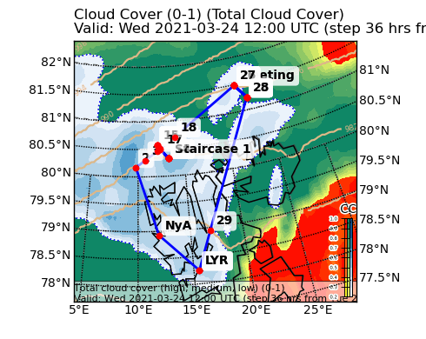
24 March 2021
Flight Plan for:
POLAR 6
Additional Maps:

Slide 5
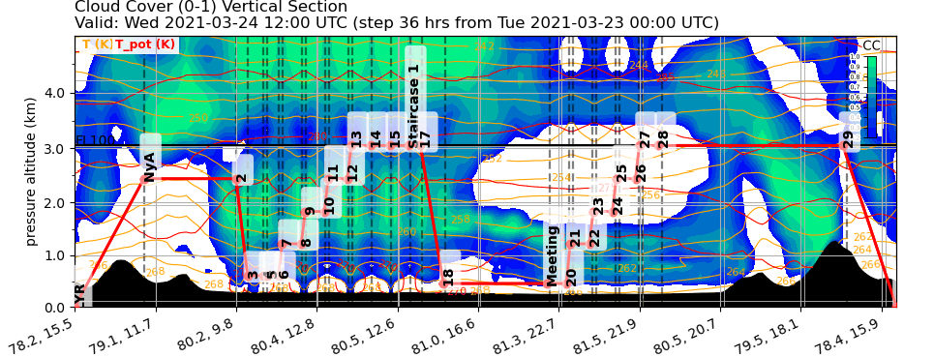
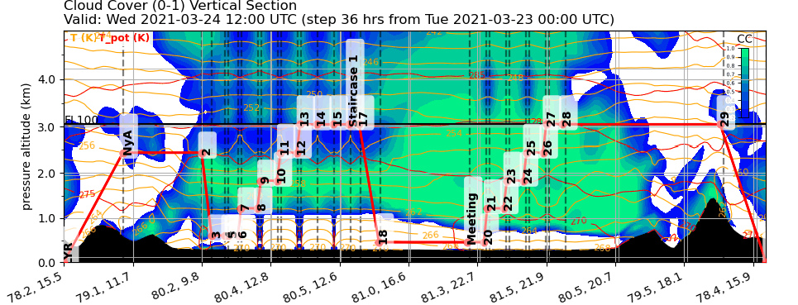
24 March 2021
Flight Plan for:
POLAR 6
ICON
ECMWF

Slide 6
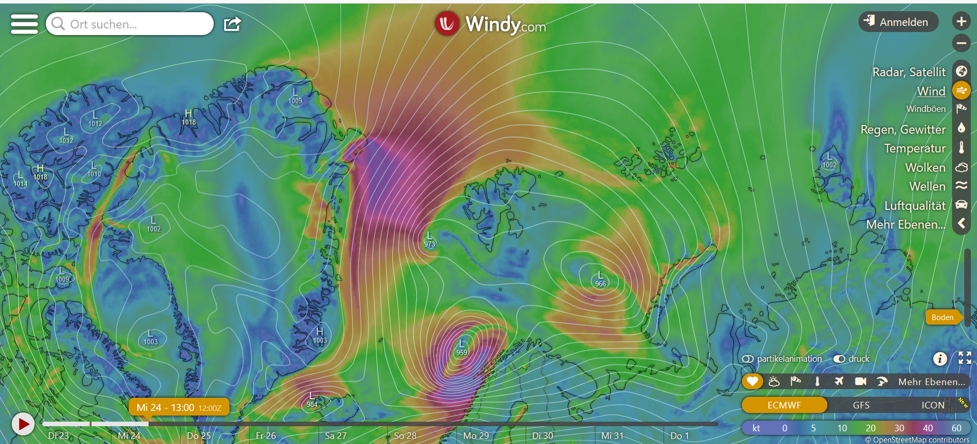
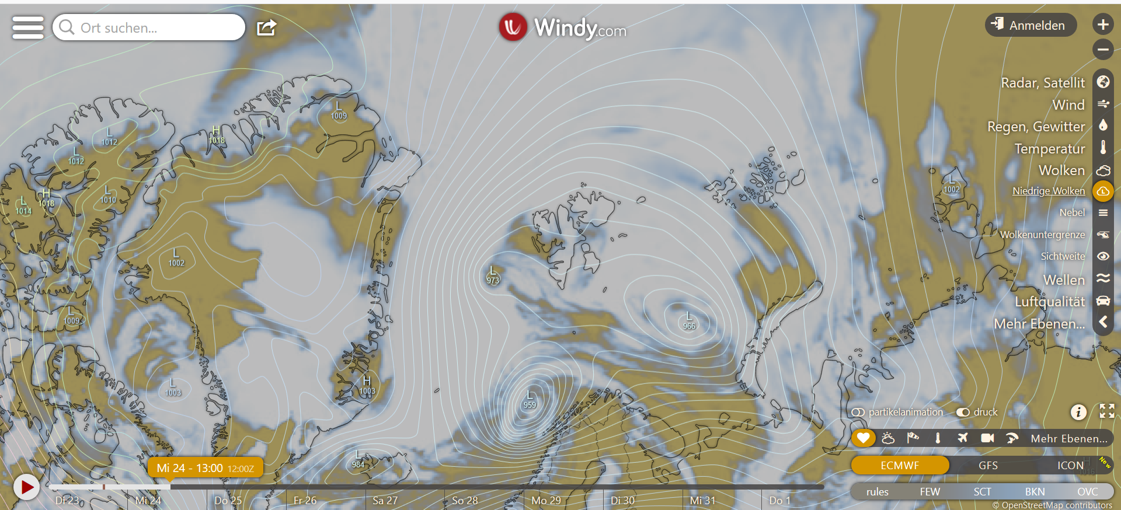
24 March 2021
Flight Plan for:
POLAR 6
Objectives of the Flight:
Large Whalers Bay polynya, accompanied with strong Norther-Easterly winds bring ing cold air to the South. The objective is to fly against the wind, parallel to the ice edge. Meeting with Polar 5 and HALO.
Polar 6 will perform two stack patterns to derive turbulence and cloud properties.
General Weather Situation:

