Slide 1
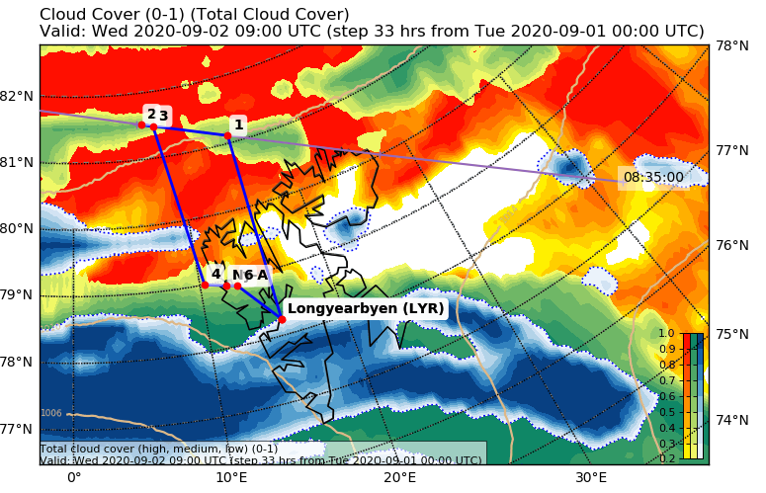
MOSAiC-ACA Flight 2020 09 02
POLAR 5
Crew: Mission PI Mario Mech
AWI Clemens Collin
AWI Martin Gehrmann
Eagle/Hawk Michael Schäfer
MiRAC Friedhelm Jansen
PMS Valerian Hahn
Est. Take Off: 09:00 LT
Est. Duration: 4.5 Hours
LYR |  | 78° 14,7‘ | 15° 28,9‘
W1 |  | 81° 7,0‘ | 15° 11,8‘ | 8:21 UTC
W2 |  | 81° 31,7‘ | 6° 54,5‘
W3 |  | 81° 29,0‘ | 8° 5,0‘
W4 |  | 79° 0,0‘ | 10° 21,6‘
W5 |  | 78° 55,4‘ | 11° 55,4‘
W6 |  | 78° 53,4‘ | 12° 51,6‘
LYR |  | 78° 14,7‘ | 15° 28,9‘
5 dropsondes

Slide 2
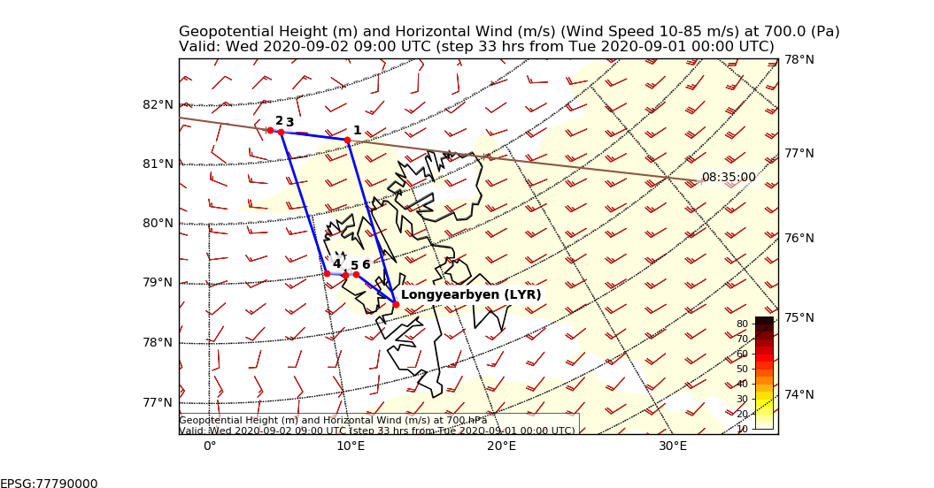
Flight Plan
LYR – W1 ascend 10,000 ft: 180 NM @180kn 60 min
W1 – W2 at 10,000 ft: 80 NM @140kn 34 min
W2 – W3 descend 200 ft with 1,000 ft/min 15 min
W3 – W2 different levels : 10 NM @120kn 30 min
W2 –W4 ascend 10,000 ft: 150 NM @180kn 50 min
W4 – NYA – W6 at 10,000 ft: 30 NM @140kn 15 min
W6 – LYR 10,000 ft: 50 NM @180kn 20 min
Total: ca 4 hr 00 min

